Slide 1

October 2025 Adoption Report

Slide 2
About Bitcoin Treasuries
Founded in 2020, BitcoinTreasuries.net is the fastest-growing, most trusted website for investors and analysts seeking Bitcoin-denominated returns in the global capital markets.
Over 300,000 people monthly now use BitcoinTreasuries.net to compare Bitcoin treasury stocks, evaluate exchange-traded Bitcoin products, and analyze corporate capital allocation across the Bitcoin and crypto sector.
This month, BitcoinTreasuries.net onboarded new partners, improved our advanced data tables, and continued to expand our listings of top treasury companies.
For marketing, media, and collaboration opportunities, email office@bitcointreasuries.net

Slide 3











Special Thanks to Our Partners

Slide 4
Introduction
October brought dramatic shifts and new signals in the corporate digital asset landscape. What began as a month of high anticipation — with Bitcoin prices hitting all-time highs before global macro shocks unleashed volatility — ended with the sector not just weathering the storm, but demonstrating remarkable resilience and adaptation.
Indeed, BitcoinTreasuries.net’s October Adoption Report reveals that, while momentum remains strong, the sector’s leading players are aggressively diversifying — ushering in a new era for digital assets and yield-driven corporate finance.
We aim to highlight the most significant shifts in Bitcoin holdings, emerging patterns in treasury strategy, and key stories that shaped institutional sentiment.
Whether you're a journalist, investor, or policymaker, these trends reflect Bitcoin’s evolution from a speculative asset to a pillar of corporate finance.

Slide 5
Contents
Monthly Summary - Key stats, trends, and highlights from the Bitcoin treasury landscape
Holdings & Valuation - Company rankings and comprehensive purchase list
Top Movers - Companies that added the most Bitcoin this month
Detailed Rankings - Biggest buys, new entrants, and entities climbing the leaderboard
Periodic Trends - Company rankings and sector breakdowns
Digital Credit - Preferred shares and high-yield dividend instruments
Expert Insights - Data and commentary from sector leaders
Stock Prices - Public treasuries with standout market performance
Notable Events - Major news and headlines
Fundraising and Capital - Newly announced and continuing fundraisers
Altcoin Holdings - ETH, SOL, XRP, and other treasuries
Future Outlook - What to expect in the coming months

Slide 6
Monthly Summary

Slide 7
October 2025 Summary
We saw public and private treasuries purchase or add over 14,400 BTC in October.
That represents fewer additions than any other month in 2025 year-to-date, but nevertheless marks continued growth in total Bitcoin holdings.
On Oct. 31, we measured more than 4.05 million BTC among all tracked entities.
  1,054,428 BTC held by public companies
  279,185 BTC held by private companies
  644,329 BTC held by governments
  1,539,951 BTC held by ETFs and exchanges
  378,061 BTC held by DeFi, smart contracts, and other
  155,707 BTC held by exchanges and custodians

Slide 8
October 2025 Summary
Treasury buying has slowed since the summer, but the most dedicated treasuries are still stacking Bitcoin and strategizing for the future. Trends in October include:
Slow but steady growth: Holdings are at an all-time high despite low monthly additions.
Stock gains: Select “pure play” Bitcoin treasury stocks are up over a 6-month period.
Digital credit: Strategy, Strive, and Metaplanet are advancing preferred share offerings that are intended to offer high-yield dividends to investors.
Share buybacks: Some experts see recent share repurchases as a way to restore value to investors amidst low mNAVs and stock valuations.
Altcoin treasuries: Ethereum (ETH) and Solana (SOL) treasuries continue to expand.

Slide 9
14,447 BTC
Net additions by private and public companies in October
Valued at $1.58 billion on Oct. 31, 2025

Slide 10
4.05 MILLION BTC
Held by all tracked entities near the end of October
Including all companies, ETFs, governments, and other entities

Slide 11
$444 BILLION
Value of all 4.05 million BTC
Based on a Oct. 31 price of $109,659.30 per BTC

Slide 12
Holdings and Valuation

Slide 13
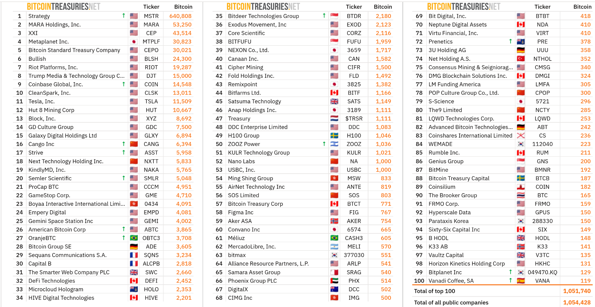
Top 100 Public Bitcoin Treasury Companies

Slide 14
October Purchases and Additions
🇯🇵 Metaplanet Inc. [MTPLF] 5268 BTC
🇺🇸 Coinbase Global, Inc. [COIN] 2772 BTC
🇺🇸 American Bitcoin Corp [ABTC] 1422 BTC
🇺🇸 Strategy [MSTR] 777 BTC
🇺🇸 MARA Holdings, Inc. [MARA] 773 BTC
🇨🇳 Cango Inc [CANG] 686 BTC
🇮🇱 ZOOZ Power [ZOOZ] 511 BTC
🇺🇸 CleanSpark, Inc. [CLSK] 308 BTC
🇯🇵 S-Science [5721] 265.5 BTC
🇸🇬 Bitdeer Technologies Group [BTDR] 182.7 BTC
🇰🇾 Prenetics [PRE] 134.6 BTC
🇬🇧 The Smarter Web Company PLC [SWC] 135 BTC
🇺🇸 Hyperscale Data [GPUS] 125.998 BTC
🇰🇷 Bitplanet Inc [049470.KQ] 128.7 BTC 🆕
🇨🇳 Jiuzi Holdings Inc [JZXN] 100 BTC 🆕
🇺🇸 Cipher Mining [CIFR] 86 BTC
🇯🇵 Gumi Inc [3903] 80.352 BTC 🆕
🇺🇸 Strive [ASST] 73 BTC
🇸🇬 BITFUFU [FUFU] 60 BTC
🇯🇵 Convano Inc [6574] 59.25 BTC
🇧🇷 OranjeBTC [OBTC3] 58 BTC
🇳🇴 ACE Digital AS [ACED] 57.95 BTC
🇰🇷 Parataxis Korea [288330] 50 BTC
🇺🇸 Canaan Inc. [CAN] 35 BTC
🇯🇵 Remixpoint [3825] 31.57 BTC
🇯🇵 Lib Work [1431] 29.643 BTC 🆕
🇫🇷 Sequans Communications S.A. [SQNS] 29 BTC
🇺🇸 Semler Scientific [SMLR] 26.92 BTC
🇨🇦 Bitcoin Well Inc [BTCW] 26.64 BTC
🇬🇧 B HODL [HODL] 26 BTC
🇺🇸 DDC Enterprise Limited [DDC] 25 BTC
🇨🇦 DevvStream [DEVS] 22.22 BTC 🆕

Slide 15
October Purchases and Additions
🇹🇭 RSXYZ PCL [XYZ] 21.97 BTC
🇸🇪 Fragbite Group [FRAG] 19.38 BTC
🇯🇵 MBK [3121] 17.6 BTC 🆕
🇪🇸 Vanadi Coffee, SA [VANA] 14 BTC
🇺🇸 CDT Equity Inc [CDT] 9.256 BTC
🇨🇦 Neptune Digital Assets [NDA] 9 BTC
🇺🇸 Exodus Movement [EXOD] 7 BTC
🇫🇷 Capital B [ALCPB] 6 BTC
🇯🇵 Mac House [7603] 5.85 BTC
🇨🇦 Matador Technologies Inc [MATA] 5 BTC
🇭🇰 WebX International [8521] 1 BTC 🆕
🇺🇸 Stacking Sats Inc [Private] 1.17 BTC
🇺🇸 Whitepaper [Private] 1.112 BTC
🇸🇪 Refine Group [REFINE] 0.65 BTC
🇬🇧 Maillot Jaune Consulting [Private] 0.49 BTC
🇺🇸 West Main Self Storage [Private] 0.348 BTC
🇦🇺 Cloud Ventures [Private] 0.116 BTC
🇺🇸 Jackson Dentistry [Private] 0.081 BTC
🇭🇺 KV Cégcsoport [Private] 0.074 BTC
🇨🇦 RCD Physical Therapy [Private] 0.068 BTC 🆕
🇺🇸 Sobtree [Private] 0.035 BTC
🇵🇱 Rocksoft [Private] 0.017 BTC
🇮🇳 OrangePill Capital [Private] 0.01 BTC
🇨🇦 DMG Blockchain Solutions [DMGI] -17 BTC
🇺🇸 Riot Platforms, Inc. [RIOT] -22 BTC
TOTAL: 14,447.27 BTC ($1.58 billion)
Based on Oct. 31, 2025 BTC price of 109,659.30
🆕 Indicates new addition to our site

Slide 16
Top Movers
Who Bought the Most BTC?

Slide 17

5,268 BTC
Largest Purchase in October

Slide 18
Metaplanet
Metaplanet bought 5,268 BTC for $615.67 million on Oct. 1.
It held 30,823 BTC ($3.4 billion) at month-end, placing it at #4 on our charts.
Metaplanet then paused stock rights exercises from Oct. 20 to Nov. 17 in an attempt to strengthen its treasury strategy amidst changing market conditions.
Although the company’s stock price is down 75% from June, CEO Simon Gerovich insists on Metaplanet’s long-term value, citing Amazon’s price drop and recovery in the 2000s as an example of stock prices underrepresenting strong company fundamentals.
Metaplanet is notably preparing to launch preferred shares similar to those offered by Strategy, intended to provide high-dividend yields to investors.

Slide 19

2,772 BTC
Second Largest Addition Recorded In October

Slide 20
Coinbase
Coinbase brought its holdings to 14,548 BTC ($1.66 billion) in the third quarter of 2025.
CEO Brian Armstrong confirmed the latest purchases, writing: “Coinbase is long bitcoin. Our holding increased by 2,772 BTC in Q3. And we keep buying more.”
The latest additions span the third quarter but were disclosed in October, making this the second largest addition that we recorded this month.
Coinbase additionally holds $616.8 million of ETH and $320.9 million of other cryptos.
All three asset groups amount to $2.6 billion of crypto held for investments.

Slide 21
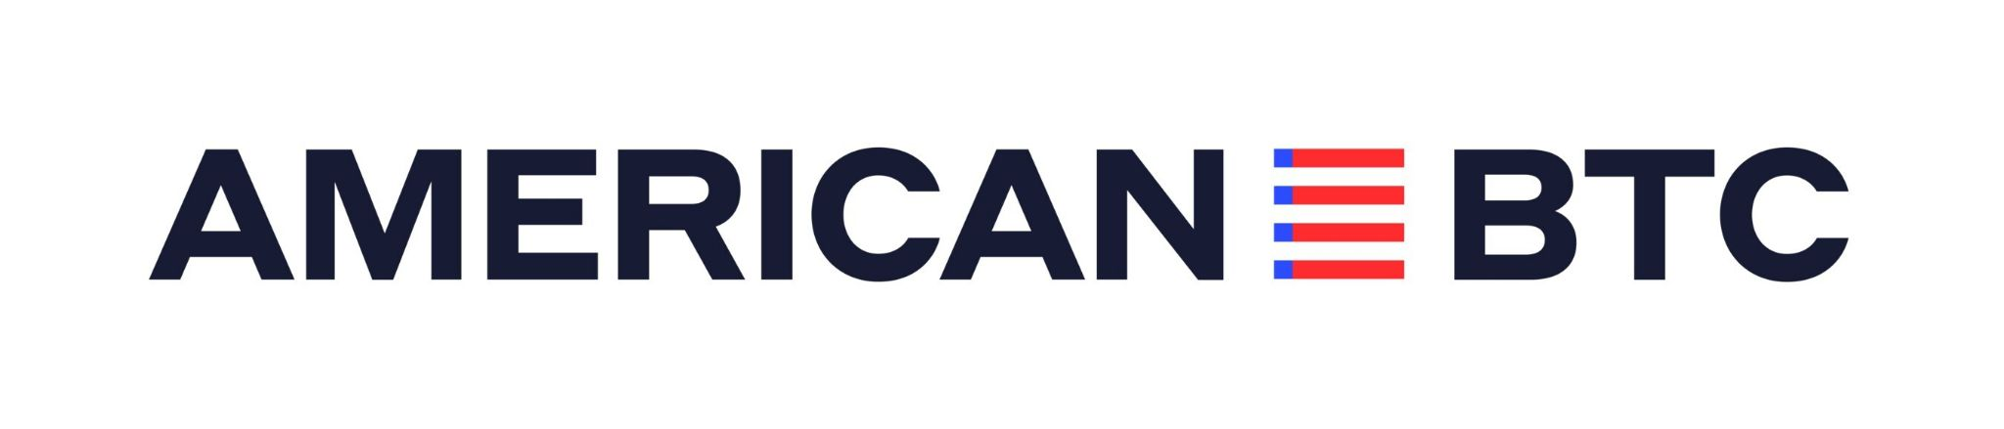
1,400 BTC
Third Largest Addition in October

Slide 22
American Bitcoin
Eric and Donald Trump Jr.’s American Bitcoin acquired over 1,400 BTC in October.
This brings the company’s month-end holdings to 3,865 BTC ($423.8 million).
American Bitcoin advertises 418 satoshis per share, up 52% from Sept. 1 to Oct. 24.
Co-founder Eric Trump said that the company will continue to report this metric, calling Bitcoin per share “one of the most important measures of success.”
The company accumulates Bitcoin through mining and strategic purchases.

Slide 23

777 BTC
Fourth Largest Addition in October

Slide 24
Strategy
Strategy bought 777 BTC in October over three weekly purchases.
At month-end, it held 640,808 BTC, worth $70.3 billion.
The company held a rare one-week pause on Bitcoin buying early in the month.
Seeking to provide investors with value, Strategy has begun to aggressively advocate for its “digital credit” instruments, or preferred shares with dividend yields targeting 10%.
Strategy also attracted attention this month as it received a B- credit rating from S&P Global, which describes a “stable outlook” for the firm alongside some concerns.

Slide 25
$120,000
Largest October Purchase by a Private Company

Slide 26
Stacking Sats Inc.
Stacking Sats Inc. purchased 1.17 BTC across three October purchases.
It spent almost $120,000 on those purchases, bringing month-end holdings near 25 BTC.
This marks the largest purchase by a private company in October.
Stacking Sats is preparing to raise an additional $500,000 to $1 million to fuel its M&A and Bitcoin accumulation strategies — and plans to secure its first credit facility in Q1 2026, deploying $2 to 4 million in new capital to expand its Bitcoin holdings.
At the helm is John Fakhoury, a Bitcoiner since 2016 known for education and community building. Fakhoury founded Church of Satoshi, a grassroots educational platform that helped onboard thousands of new Bitcoiners during 2021–2022.

Slide 27

Executive Commentary
“At Stacking Sats Inc., we’re not reacting to market mood swings or stock performance. Our focus is on fundamentals—building, acquiring, and compounding value in Bitcoin terms.”
“Real companies with real profits will lead the next chapter of Bitcoin treasuries.”
– Stacking Sats / Framework IT CEO John Fakhoury
Image: Framework IT

Slide 28
Detailed Rankings

Slide 29
Top 10 Public Company Treasuries at Month End
As of Sept. 30, 2025
As of Oct. 31, 2025
 | Company | Ticker | BTC
1 | Strategy | MSTR | 640,031
2 | MARA Holdings | MARA | 52,477
3 | XXI | CEP | 43,514
4 | Bitcoin Standard Treasury Company | BSTR | 30,021
5 | Metaplanet Inc. | MTPLF | 25,555
6 | Bullish | BLSH | 24,300
7 | Riot Platforms, Inc. | RIOT | 19,309
8 | Trump Media & Technology Group | DJT | 15,000
9 | CleanSpark, Inc. | CLSK | 12,703
10 | Coinbase Global, Inc. | COIN | 11,776
 | Company | Ticker | BTC
1 | Strategy | MSTR | 640,808
2 | MARA Holdings, Inc. | MARA | 53,250
3 | XXI | CEP | 43,514
4 ▲ | Metaplanet Inc. | MTPLF | 30,823
5 ▼ | Bitcoin Standard Treasury Company | CEPO | 30,021
6 | Bullish | BLSH | 24,300
7 | Riot Platforms, Inc. | RIOT | 19,287
8 | Trump Media & Technology Group | DJT | 15,000
9 ▲ | Coinbase Global, Inc. | COIN | 14,548
10▼ | CleanSpark, Inc. | CLSK | 13,011

Slide 30
Public Companies Top 15 Additions Private Companies Top Additions
 | Company | BTC Added | Value
1 | Metaplanet Inc. | 5268 | $577.7M
2 | Coinbase Global, Inc. | 2772 | $304.0M
3 | American Bitcoin Corp | 1422 | $155.9M
4 | Strategy | 777 | $85.2M
5 | MARA Holdings, Inc. | 773 | $84.8M
6 | Cango Inc | 686 | $75.2M
7 | ZOOZ Power | 511 | $56.0M
8 | CleanSpark, Inc. | 308 | $33.8M
9 | S-Science | 265.5 | $29.1M
10 | Bitdeer Technologies Group | 182.7 | $20.0M
11 | Prenetics | 134.6 | $14.8M
12 | The Smarter Web Company | 135 | $14.8M
13 | Hyperscale Data | 125.998 | $13.8M
14 | Bitplanet Inc | 128.7 | $14.1M
15 | Jiuzi Holdings Inc | 100 | $11.0M
 | Company | BTC Added | Value
1 | Stacking Sats Inc | 1.17 | $128.3K
2 | Whitepaper | 1.112 | $121.9K
3 | Maillot Jaune Consulting Ltd | 0.49 | $53.7K
4 | West Main Self Storage | 0.348 | $38.2K
5 | Cloud Ventures | 0.116 | $12.7K
6 | Jackson Dentistry | 0.081 | $8.9K
7 | KV Cégcsoport | 0.074 | $8.1K
8 | RCD Physical Therapy | 0.068 | $7.5K
9 | Sobtree | 0.035 | $3.8K
10 | Rocksoft | 0.017 | $1.9K
11 | OrangePill Capital | 0.01 | $1.1K
Oct. 2025 additions only, based on Oct. 31 price of $109,659.30 per BTC

Slide 31
Top New Buyers and Additions to Our Listings
We recorded just a few companies that bought Bitcoin for the first time in October — or had their treasury additions come to public attention for the first time during the month.
“Korean Public Company Bitplanet Kicks Off Treasury Plan, Buys Bitcoin as Market Rebounds” – Decrypt
“Jiuzi Holdings Launches $1 Billion Bitcoin Treasury with SOLV to Drive Institutional Yields and RWA Innovation” – Press release
“Japanese Real Estate Firm [Lib Work] Enters Bitcoin Market with $3.3 Million Acquisition” – BeInCrypto
“DevvStream Reports BTC and SOL Reserves as Crypto-Treasury Program Accelerates” – Press release
“Japanese Loans Giant MBK Announces $2M Bitcoin Purchase, Crypto Exchange Deal” – Cryptonews
Company | BTC Added | Type
Bitplanet Inc | 128.7 | Public
Jiuzi Holdings Inc | 100 | Public
Gumi Inc | 80.352 | Public
Lib Work | 29.643 | Public
DevvStream | 22.22 | Public
MBK | 17.6 | Public
WebX International | 1 | Public
RCD Physical Therapy | 0.068 | Private

Slide 32
Periodic Trends

Slide 33
Number of Tracked Entities
How Many Companies Hold Bitcoin?

Slide 34
Number of Entities Holding Bitcoin
As of Oct. 31, we tracked 353 entities holding Bitcoin, including 276 public and private companies. Our listing count has more than doubled since January, representing rapid Bitcoin adoption by companies.
We’ve added eight entities since our previous report (or nine entities over 30 days) — primarily public and private treasuries.
Publicly traded Bitcoin treasury firms continue to dominate our listings in terms of company count. We believe public companies are the main entity type to watch for new listings and purchases.

Slide 35
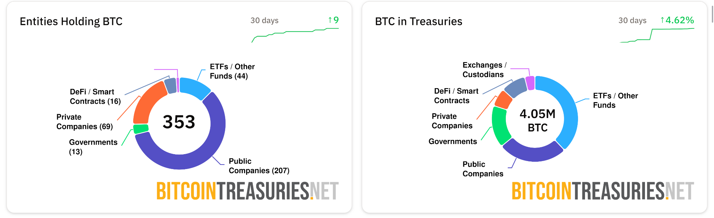
Entities Holding Bitcoin (Number of Holders)
Chart and data: BitcoinTreasuries.net, Oct. 31

Slide 36
Entities Holding Bitcoin (Amount Held)
Chart and data: BitcoinTreasuries.net, Oct. 31

Slide 37
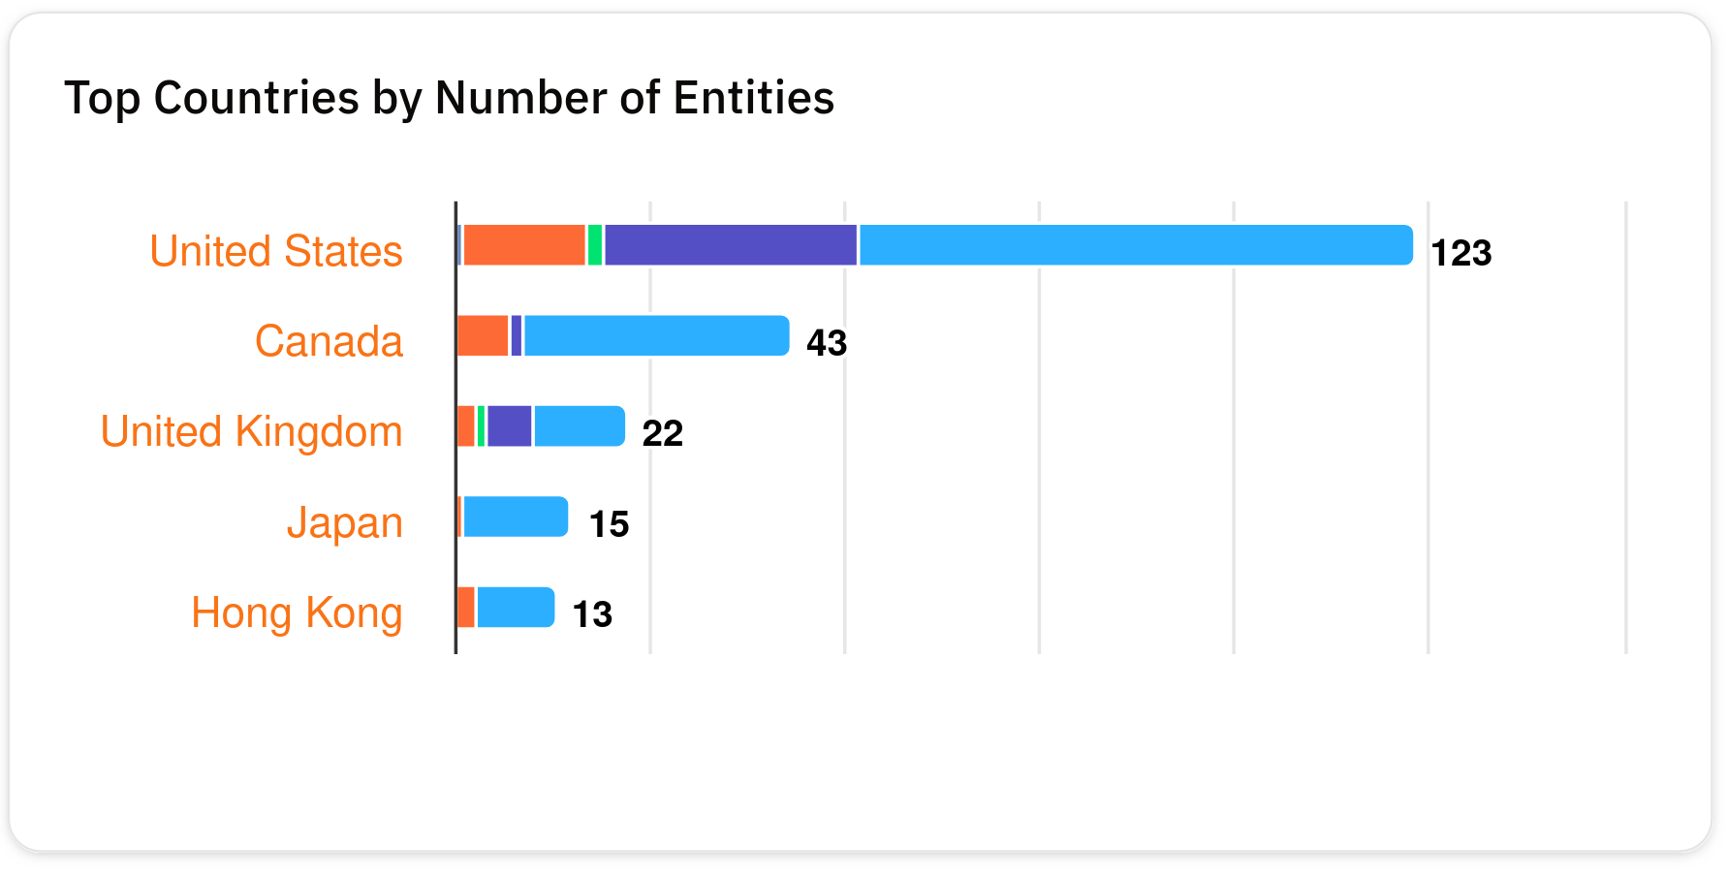
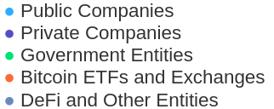
Entities Holding Bitcoin (By Country)
Chart and data: BitcoinTreasuries.net, Oct. 31

Slide 38
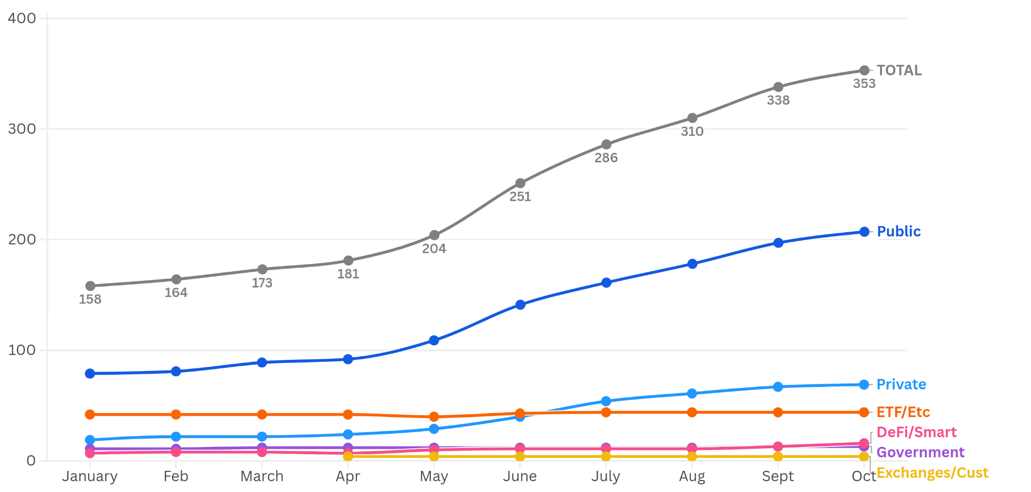
Entities Holding Bitcoin (Historical Data)
Chart and data: BitcoinTreasuries.net

Slide 39
Monthly and Quarterly Additions
How Much BTC Has Been Bought or Added Over Time?

Slide 40
Bitcoin Added By Public Companies
Public treasury companies added over 14,400 BTC in October — representing the smallest one-month increase in Bitcoin holdings this year.
This also marks an immediate decline in additions compared to September, when we saw public companies add over 38,035 BTC.
However, steady accumulation has paid off. As Bitcoin prices hit $115,907 on Oct. 28, public treasuries held 1.05 million BTC worth $122 billion. That’s 1.85x growth in USD value since the end of January against a 1.7x increase in Bitcoin holdings.
Furthermore, there were few sales to offset October purchases. We saw companies sell just 39 BTC in October, with most holding their Bitcoin tightly.

Slide 41
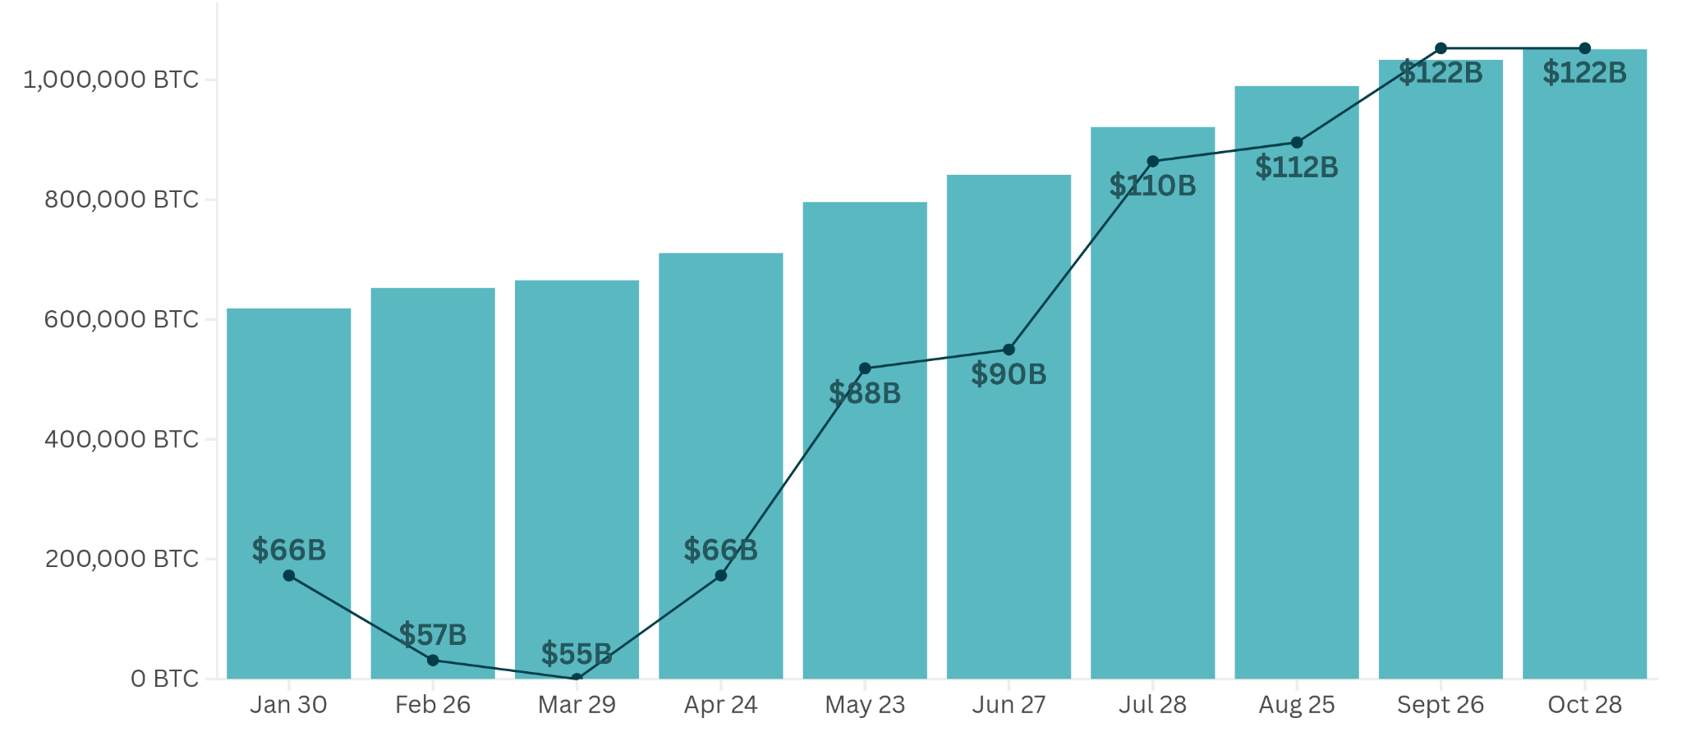
Total BTC Holdings vs. Dollar Value Growth
Chart and data: BitcoinTreasuries.net – historical dates and dollar values chosen at our discretion

Slide 42
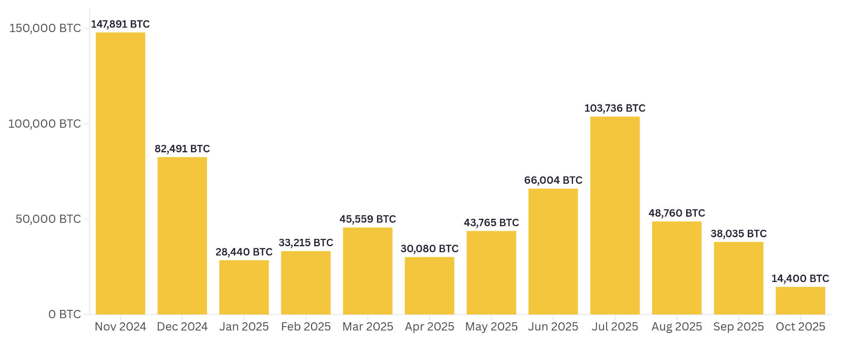
Bitcoin Added By Public Companies (Monthly)
Chart and data: BitcoinTreasuries.net

Slide 43
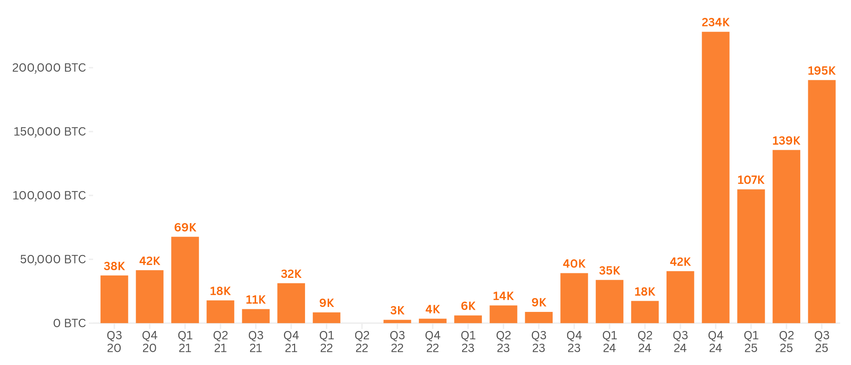
Bitcoin Added By Public Companies (Quarterly)
Chart and data: BitcoinTreasuries.net – Negative quarterly changes not shown

Slide 44
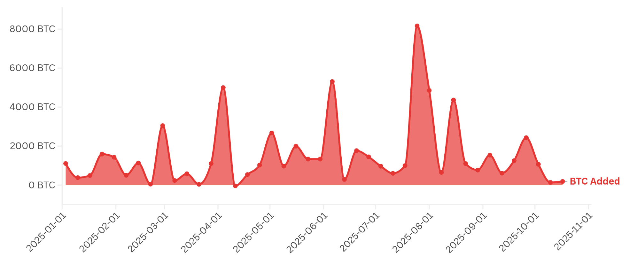
Bitcoin Added Daily By Public Companies (7 Day Average)
Chart and data: BitcoinTreasuries.net

Slide 45
Strategy Dominance
Michael Saylor’s Strategy remains the single most dominant Bitcoin treasury by a wide margin, holding over 641,000 BTC as of early November.
However, long-term trends indicate that other treasury companies are collectively challenging its dominance. Strategy now accounts for just 60% of all treasury holdings, versus 75% in January 2025 and 69% in January 2024.
Furthermore, whether Strategy leads monthly Bitcoin purchases is highly variable, with it executing an aggressive buying strategy over the last quarter of 2024 compared to smaller purchases spread out over most of 2025.

Slide 46
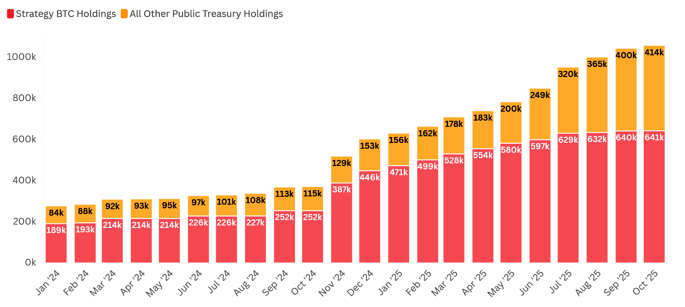
Strategy Dominance – Holdings at End of Month
Chart. BitcoinTreasuries.net. Public treasury data: BitcoinTreasuries.net. Strategy data: Strategy.com.

Slide 47
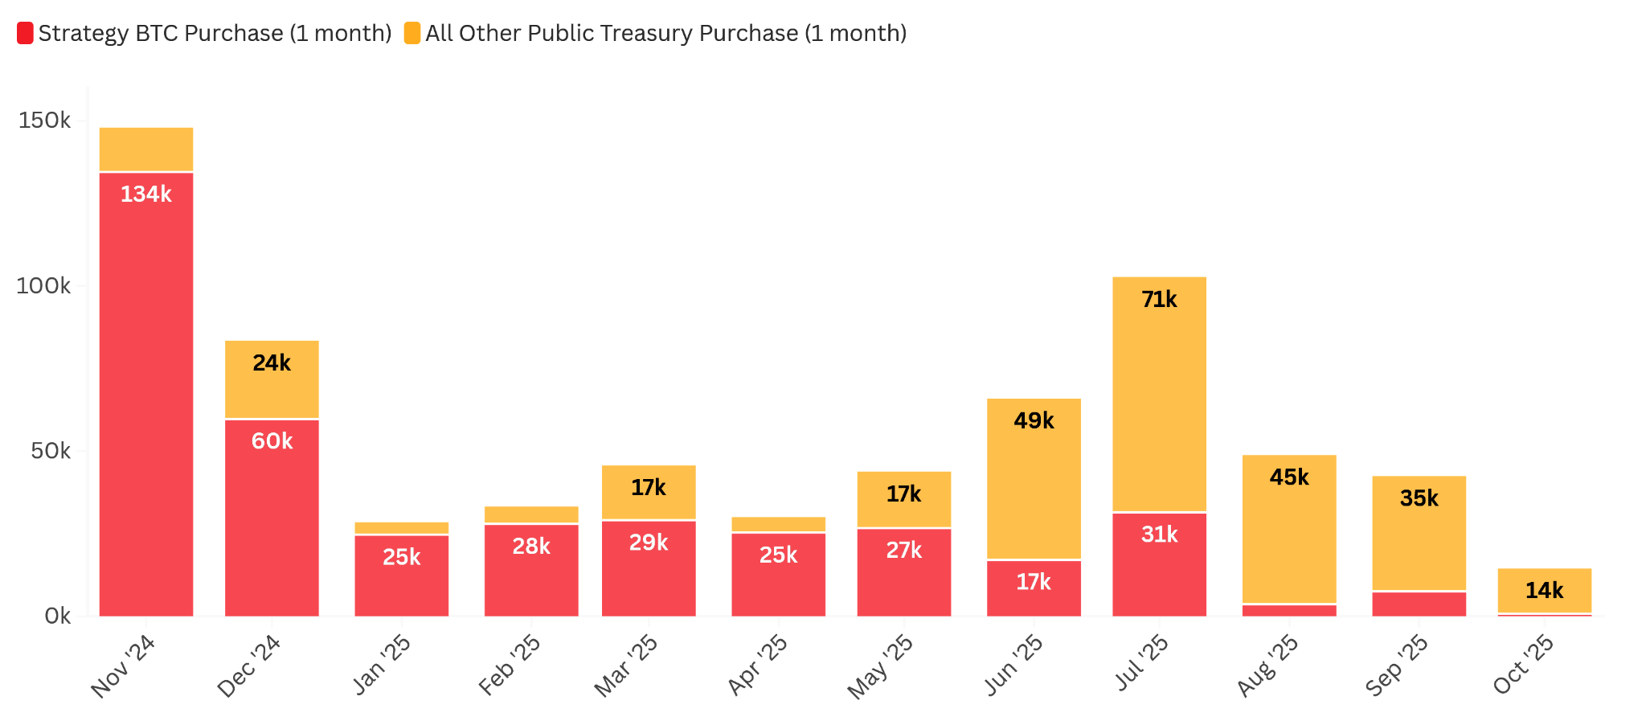
Strategy Dominance – Monthly Purchases
Chart. BitcoinTreasuries.net. Public treasury data: BitcoinTreasuries.net. Strategy data: Strategy.com.

Slide 48
Digital Credit
High-Yield Dividend Instruments

Slide 49
Debt and Equity Fundraising
A new funding strategy is on the rise: preferred shares or “digital credit.”
Bitcoin treasury companies can issue these financial instruments to raise capital while offering investors high-yield dividends in the range of 8-12% annually.
Strategy pioneered this approach with four instruments (STRC, STRD, STRK, and STRF), while Metaplanet and Strive are preparing to follow suit.
Though some commentators have raised concerns around potential challenges in dividend payments, others see these financial instruments as a new frontier for Bitcoin treasury strategies and a trend that’s ripe for widespread adoption.

Slide 50

Why Digital Credit is Superior to Traditional Credit
1. Simple: One asset, clear capital structure.
2. Liquid collateral: Bitcoin trades globally, 24/7.
3. Liquid credit: Fixed-income traded on Nasdaq.
4. Over-collateralized: Every note is backed 3x or more.
5. Quantifiable risk: BTC's volatility and [compound annual growth rate] make risk measurable.
– Joe Burnett, Lead Researcher, Semler Scientific (X)
Image: LinkedIn

Slide 51
Case Study: Strategy
Digital Credit in US and International Markets

Slide 52
Strategy’s Digital Credit
This month, Strategy increased its focus on its “digital credit” products — preferred shares with about $6.7 billion of outstanding value, offering investors high-yield investments while raising capital for the company’s Bitcoin purchases.
Instruments in Strategy’s product line include Strife (STRF), Stretch (STRC), Strike (STRK), and Stride (STRD). Its flagship product, STRC, targets fluctuating annual returns near 10% and a stable price close to $100 per share.
And now Strategy is pursuing efforts to launch similar products globally, including a new share class, STRE, which is aimed at European investors.

Slide 53

STRC as a High-Yield Account
“ STRC represents us stripping away the volatility and the risk from a commodity from Bitcoin, the digital capital instrument, and then distilling out a particular currency, USD, [and] a particular yield — say 10% on STRC and then a certain duration for that yield.”
“STRC, I think, represents kerosene. It's like extracting jet fuel from a barrel of crude oil ….”
“Everybody in the world would love to have a high yield bank account that yielded 10% or more …. We have shown that you can extract that sort of instrument from raw Bitcoin if you have enough Bitcoin.”
— Michael Saylor, Strategy executive chair (Bloomberg)
Image: Strategy

Slide 54
Digital Credit in International Markets
“We have an opportunity not just in the U.S., but in the Middle East, in Great Britain, in Australia, in Canada, in Korea and everywhere in Europe, in Singapore, in Japan and in Switzerland. And we're studying each of these markets, and we're thinking very hard because we can create a digital credit instrument in Great British pounds, or in Canadian [dollars], or in euros, or in Swiss francs. So we create the currency we want. We put the appropriate amount of risk on it.
“We strip away the duration and then we start selling pure yield. That is the compelling use case. And so are we on a mission? Yes. We're on a mission. We're on a mission to basically give everybody a bank account that yields 10%, or in this case, a money market that yields 16.5% tax equivalent, right? We want to change people's view toward money, change their view toward credit. And it's not very complicated to figure out why you might want to do it. And I don't think it will be complicated for people to figure out why they might want to own these instruments.”
— Michael Saylor, Strategy executive chair, Q3 2025 Earnings Call

Slide 55
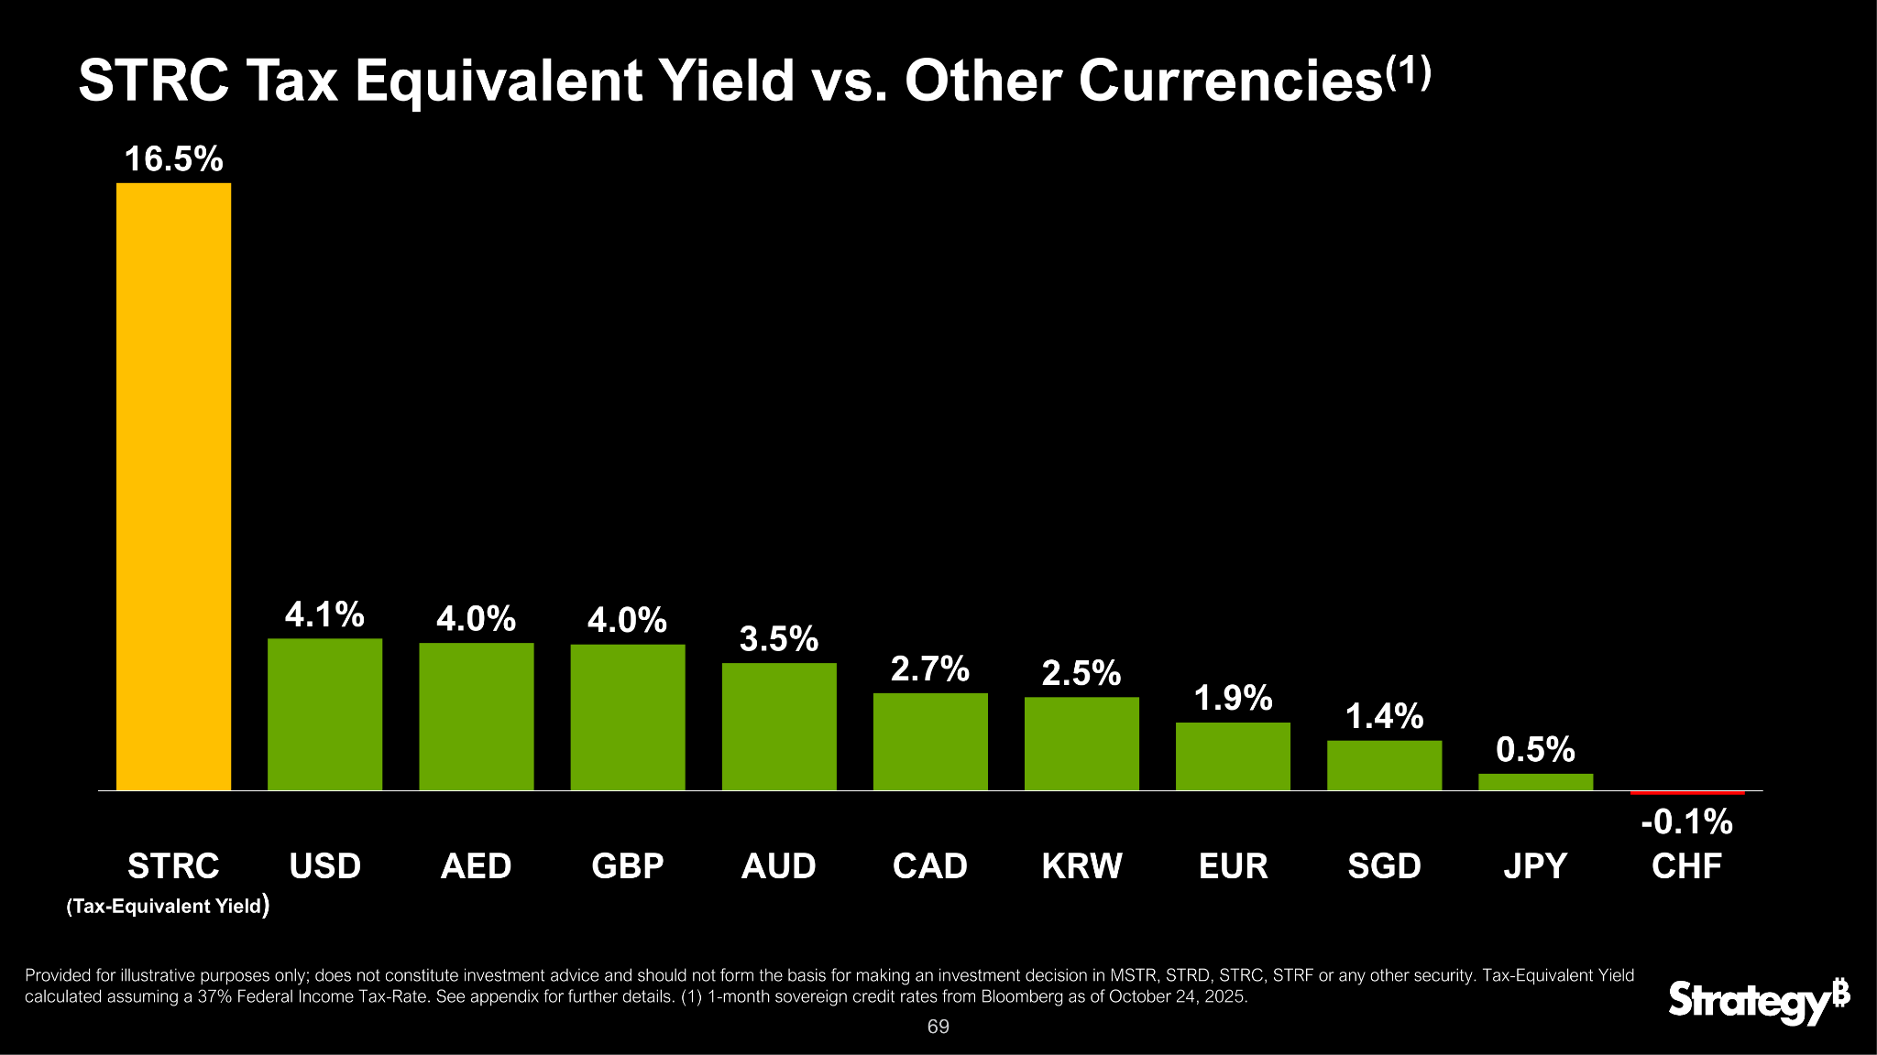
How Much Could STRC Return for Global Investors?
Image: Strategy

Slide 56
Case Study: Strive
SATA Preferred Stock Set to Pay Dividends In December

Slide 57
Strive’s SATA Stock
Strive announced its own high-yield offering — SATA, a variable-rate perpetual preferred stock targeting 12% annual dividends starting December 15, 2025.
The company listed SATA on Nasdaq on Nov. 10, offering 2,000,000 shares priced at $80 each. Strive has since purchased $160 million of BTC with proceeds from the offering — buying 1,567 BTC to bring its total holdings to 7,525 BTC.
Strive upsized the offering from 1.25 million shares prior to the listing date and reported after the listing that the offering was oversubscribed.
This suggests strong investor demand for such investment vehicles — and evidence that this could be a valuable model for similar treasuries.

Slide 58
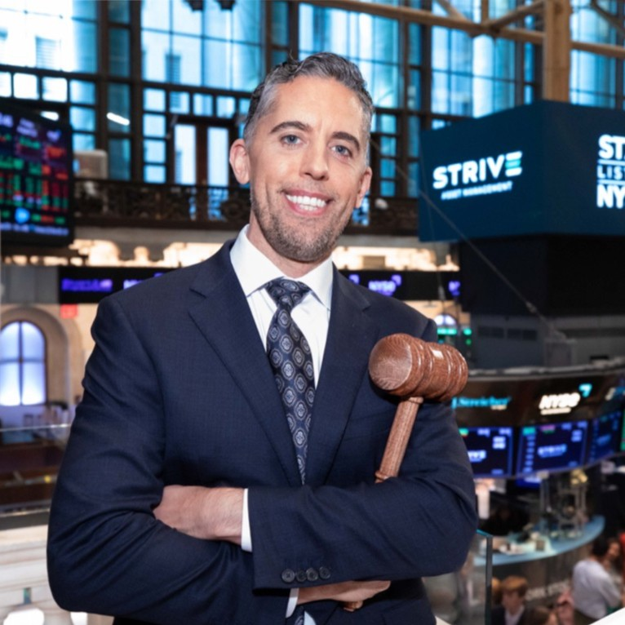
Executive Comment
“The Strive Bitcoin Treasury model is intentionally simple. Our common equity functions as amplified Bitcoin capturing the excess return above our financing cost for investors and benefits from any additional accretive alpha or beta opportunities to expand Bitcoin exposure.
“The preferred equity represents Bitcoin-powered yield, our leverage toggle, and sits senior in our equity capital structure … we believe they form a balanced and transparent framework. “
“We intend for our common equity and SATA to be the only two securities in our capital structure for at least the next 12 months prior to giving effect to the Semler merger and plan to focus on building out the liquidity profile for SATA as both our common equity and preferred equity securities scale.”
— Matt Cole, Chairman and Chief Executive Officer of Strive, Investor SATA Presentation
Image: LinkedIn

Slide 59

Executive Comment
“We're very excited about the launch of SATA …”
“For those of you who may have worked in computing, SATA may sound familiar as a simple cable that connects a storage device to a computer's motherboard. In the same way, the SATA perpetual preferred equity connects Bitcoin powered digital credit to traditional finance.”
“Capital enters on the legacy rails. The store of value is upgraded through Bitcoin and value flows back as a listed familiar rules-based security with an attractive dividend yield. Same rails, new capability, linking traditional fixed income structures to next-generation assets.”
— Ben Werkman, CIO of Strive, Investor SATA Presentation
Image: Strategic Bitcoin Reserve Summit

Slide 60
Case Study: Metaplanet
Preferred Shares in the Japanese Market

Slide 61
Metaplanet’s Perpetual Preferred Shares
On Oct. 28, Metaplanet confirmed that it has authorized the issuance of perpetual preferred shares through shareholder approval.
The company writes: “To maximize BTC Yield accretion, [Metaplanet] will actively promote the use of perpetual preferred shares. This approach is intended to enhance long-term shareholder value in BTC terms with minimal refinancing risk.”
The strategy has been planned since at least August, with tentative plans to issue 555 million preferred shares for ¥555 billion ($3.8 billion) — capturing a significant portion of its total addressable market (TAM) in Japan.

Slide 62

Executive Comment
“ … A key question is why preferred shares are a more powerful tool than issuing common stock. The answer lies in how we can continue increasing Bitcoin per share without depending on equity issuance.”
“When a company raises common equity, it increases its Bitcoin holdings but also the number of shares. That dilution can slow Bitcoin per share growth. Preferred shares allow us to raise capital at a fixed dividend rate without increasing the number of common shares. …”
“ … In simple terms, preferred shares make it possible to expand Bitcoin holdings without dilution, and grow bitcoin per share irrespective of mNAV.”
– Metaplanet President Simon Gerovich, X
Image: Metaplanet

Slide 63
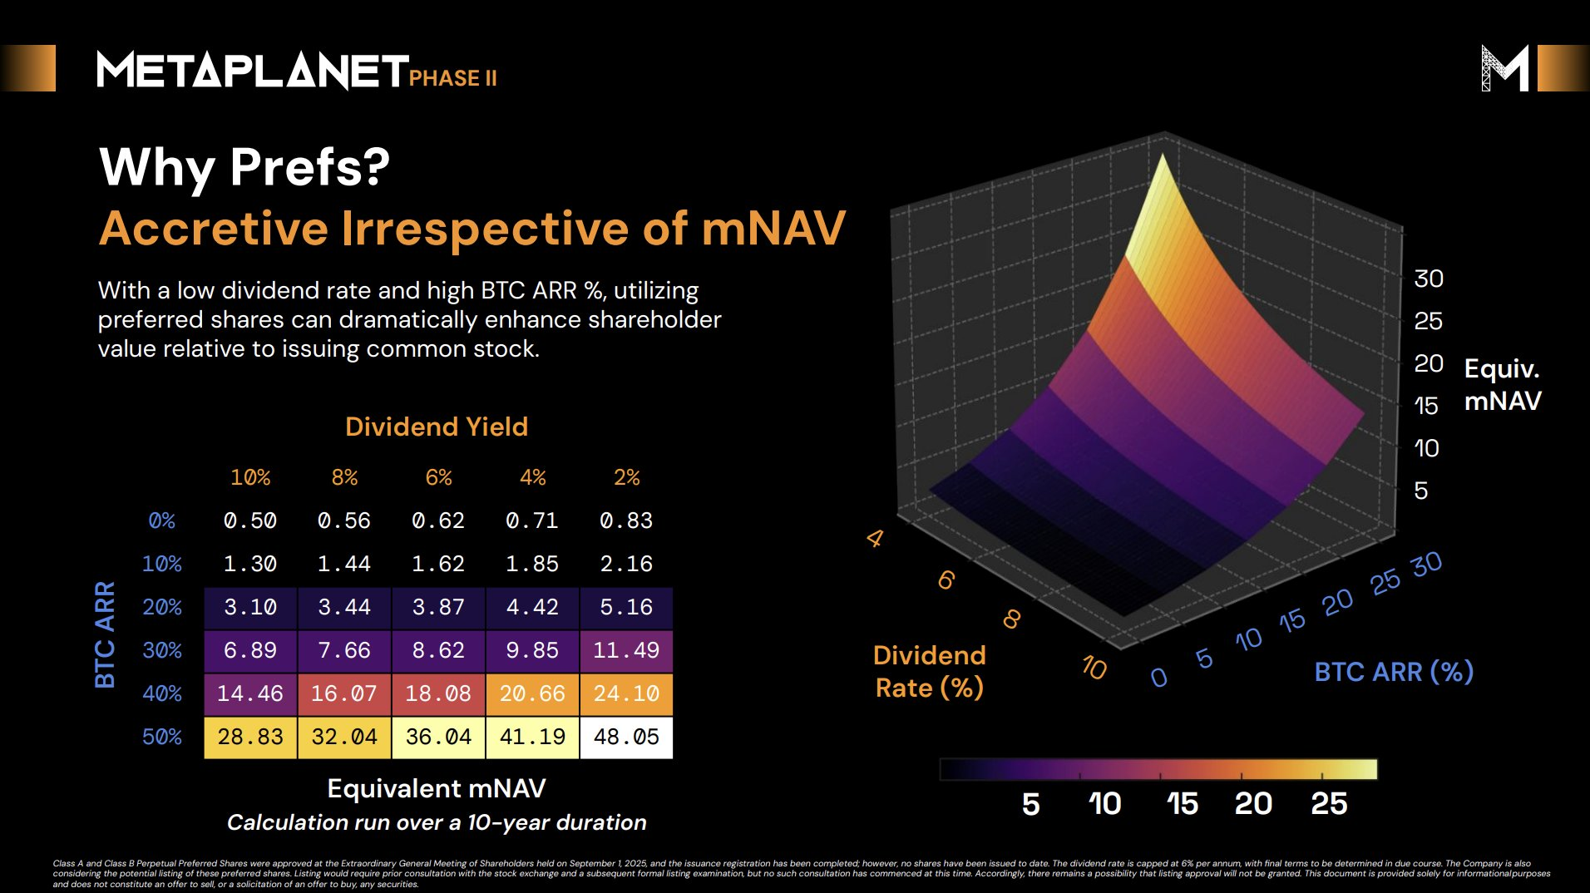
How Preferred Shares Can Build Investor Value
Image: Simon Gerovich / Metaplanet

Slide 64
Expert Insights

Slide 65
Expert Insights
This month, we’ve collected insights from several experts, who join us to discuss Bitcoin fundamentals and price outlook, market-to-Bitcoin NAV (mNAV) trends, and other ways to evaluate the future potential of Bitcoin treasuries.
Plus, we dive into Fidelity analysts’ recent report on how treasury holdings contribute to Bitcoin’s non-circulating or “illiquid” supply.
Together, these insights paint an optimistic outlook for Bitcoin treasuries in the near-term and long-term, even in a market that is weak by some measures.

Slide 66
Market to Bitcoin NAV (mNAV)
Does the Company Trade at a Premium to Its BTC Holdings?

Slide 67
Market to Bitcoin mNAV
Market to Bitcoin NAV (mNAV) remains a critical and widely observed method for determining the value of public Bitcoin treasury companies.
Critics note that Bitcoin treasuries frequently underperform by this metric, trading at a discount with mNAVs below 1. Furthermore, recent data from Protos shows a downtrend in mNAVs for select treasuries.
However, many companies with a dedicated treasury strategy report and strategize around mNAV — often maintaining a target mNAV near or above 1, representing a fair valuation or slight premium compared to Bitcoin holdings.
As investors continue to search for new investing opportunities, some suggest alternative metrics should come into greater focus.

Slide 68
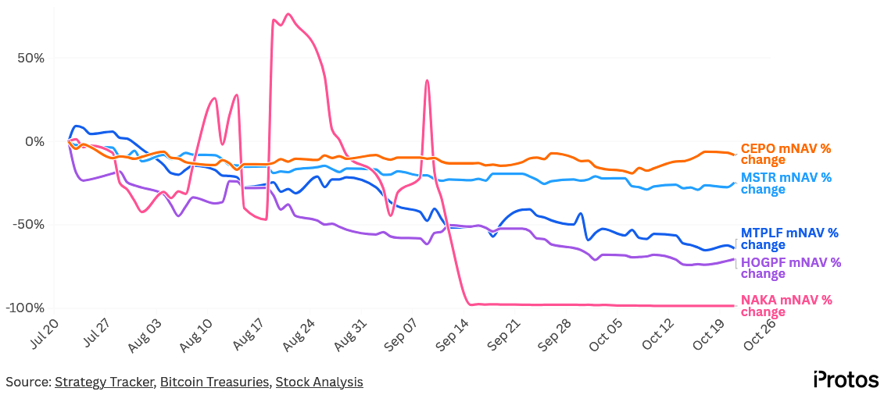
Protos: “mNAV down across bitcoin treasury companies”
Chart: Protos – Oct. 24

Slide 69
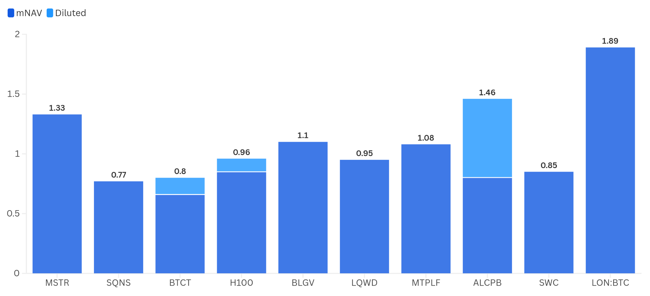
Self-Reported mNAVs
Chart: BitcoinTreasuries.net — All data from official company dashboards Nov. 3

Slide 70
Media Signal: 10X Research
“The age of financial magic is ending for Bitcoin treasury companies. They conjured billions in paper wealth by issuing shares far above their real Bitcoin value—until the illusion vanished. Now, those once-celebrated NAV premiums have collapsed, leaving investors holding the empty cup while executives walked away with the gold.”
“The question isn’t whether the trick worked—it’s what comes next when the smoke clears. With volatility falling and the easy gains gone, these firms face a hard pivot from marketing-driven momentum to real market discipline.”
“The next act won’t be about magic—it will be about who can still generate alpha when the audience stops believing.”
10X Research – After the Magic: How Bitcoin Treasury Firms Must Evolve Beyond NAV Illusions

Slide 71

Expert Commentary
“I view mNAV as a measure of market sentiment. It’s a forward-looking assessment of the market.”
“Projecting it into the future becomes very difficult because it’s strongly, if not entirely, driven by market sentiment. That’s why the market is paying that premium — it’s assuming the stock will outperform and is willing to pay today for outperformance tomorrow.”
“I think mNAV is going to represent the market's view around Bitcoin, around the equity, and around how that particular company can leverage its Bitcoin in the future. If I had to distill it down to three primary factors, those would be the three.”
“I'm looking at execution, strategy, and methodology, I'm looking at the framework that the particular Bitcoin treasury has.”
– Adrian Morris, Lead Equity Analyst, MSTR True North
Image: NYC Unconference

Slide 72
Share Buybacks
How Are Companies Resisting Share Devaluation?

Slide 73
Share Buybacks
Stock and share buybacks abounded this month.
At least five Bitcoin treasuries and four altcoin treasuries announced or continued to pursue share buybacks in and around October.
Critics argue that stock buybacks indicate that Bitcoin treasury strategies are failing to generate value. However, proponents believe that buybacks can benefit shareholders by driving up share prices even in difficult market conditions.
Any short-term gains in share price have been moderate, and it remains to be seen whether buyback strategies will ultimately benefit shareholders in the long term.

Slide 74
Share Buybacks Bitcoin Treasuries
Metaplanet announced plans to repurchase up to 150 million common shares, or about 13% of its total issued shares, backed by a $500 million line of credit [Oct. 27]
LM Funding announced a $1.5 million share buyback program, or 15% of outstanding common stock, to reduce dilution and increase asset value per share [Nov. 3]
Sequans Communications launched a program to repurchase 1.57 million ADS shares, or approximately 10% of its outstanding ADS shares [Oct. 1]
Empery Digital posted an update on its ongoing share $150 million buyback program, stating that after the latest buybacks $76 million remains available for future repurchases [Nov. 3]
OranjeBTC repurchased 99,600 shares for 1.12 million Brazilian reals ($220,000) [Oct. 31]

Slide 75
Share Buybacks Altcoin Treasuries
EthZilla sold $40 million of its ETH holdings to fund share buybacks and has already bought 600,000 shares for $12 million — part of an ongoing $250 million repurchase program [Oct. 27]
Ethereum treasury FG Nexus began a $200 million share repurchase program focused on buying back shares below NAV, which will permit its partner ThinkEquity to repurchase 25% of the daily trading volume while the stock trades below $5.00 per share [Oct. 20]
Nano Labs, a BNB-focused treasury, announced up to $25 million share repurchases [Oct. 15]
Forward Industries’ board authorized a $1 billion share buyback program in conjunction with its ongoing Solana treasury strategy [Nov. 4]

Slide 76
Case Study: Metaplanet
Metaplanet's share buyback program involves repurchasing up to 150 million common shares, or about 13% of its outstanding stock, to improve capital efficiency and address the decline in its market Net Asset Value (mNAV).
The company has allocated about 75 billion JPY to repurchases, supported by a credit facility with a maximum borrowing limit of $500 million (76.4 billion JPY).
The year-long buyback will run from October 29, 2025, through October 28, 2026. The company repurchased no shares before the end of October 2025.
We find that stock prices rose around the time of the Oct. 28 announcement, but that prices have once again fallen, with long-term outlook unclear.

Slide 77
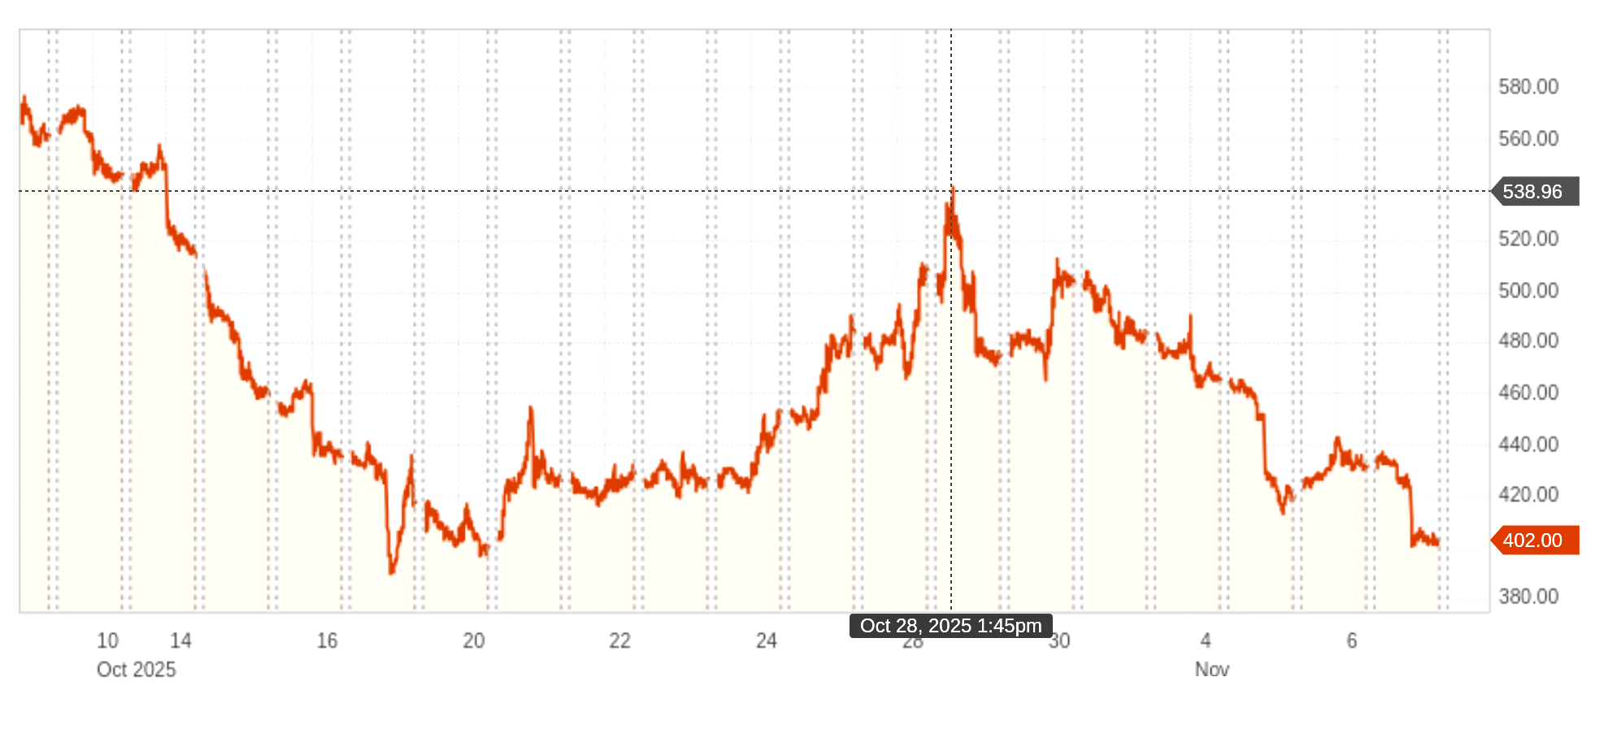
Metaplanet Share Buyback
Oct. 28 1:17 PM JST Metaplanet shares *Notice Regarding the Establishment of Share Repurchase Program* On X
Chart: Reuters, Nov. 6

Slide 78
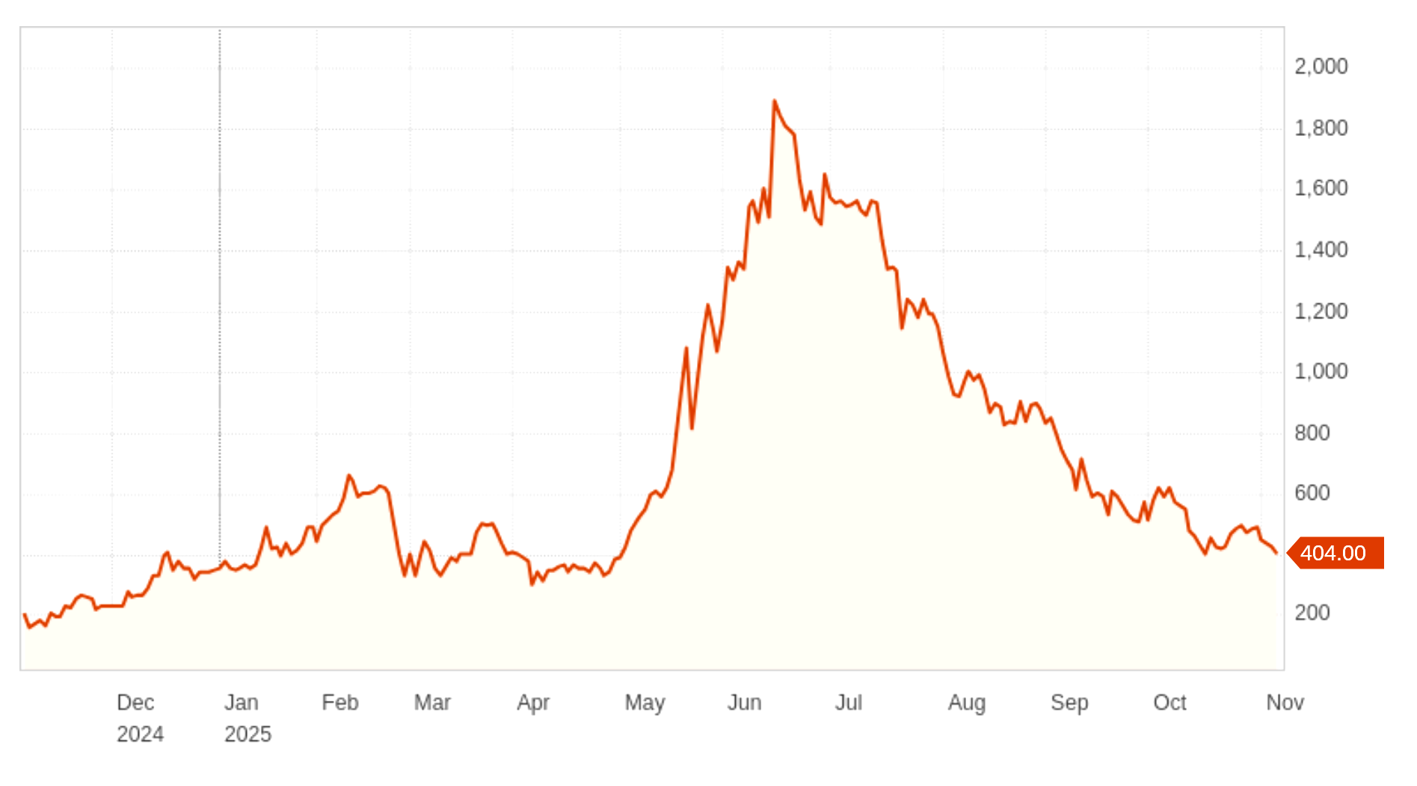
Metaplanet Share Buyback
Share buyback
notice – Oct. 28
Close: 499 JPY
Chart: Reuters, Nov. 6

Slide 79

Expert Commentary
“It was great to see Metaplanet announce having the optionality for share buybacks.”
“This can act as a deterrent for short selling and can increase Bitcoin per share for the common equity holders if executed at below 1x mNAV. “
“I think we will likely see other companies in the sector make a similar move in the coming months in an attempt to build a "floor" … and [if] this floor is established at a magnet mNAV of 1.0, shareholders by default match Bitcoin-equivalent returns. This is huge for the perceived safety of investing in Bitcoin treasury companies.”
— Adam Livingston, Bitcoin and capital markets educator
Image: LinkedIn

Slide 80
Illiquid Bitcoin Supply
How Much BTC Is Locked Up By Corporate Treasuries?

Slide 81
Illiquid Bitcoin Supply
Treasuries that are resistant to selling Bitcoin are an important contributor to the illiquid Bitcoin supply, i.e. Bitcoin that has been issued but is not actively transferred between addresses.
Fidelity Digital Assets finds that Bitcoin treasuries are increasingly responsible for the illiquid supply:
“Bitcoin is seemingly entering a new era, led by two main cohorts: long-term holders and public companies. The addition of corporate treasuries into the illiquid supply category has accelerated the pace of accumulation.”
The chart on the next page represents the amount of BTC held by public companies in orange, or about 5 percentage points of the projected 42% illiquid supply in 2025.

Slide 82
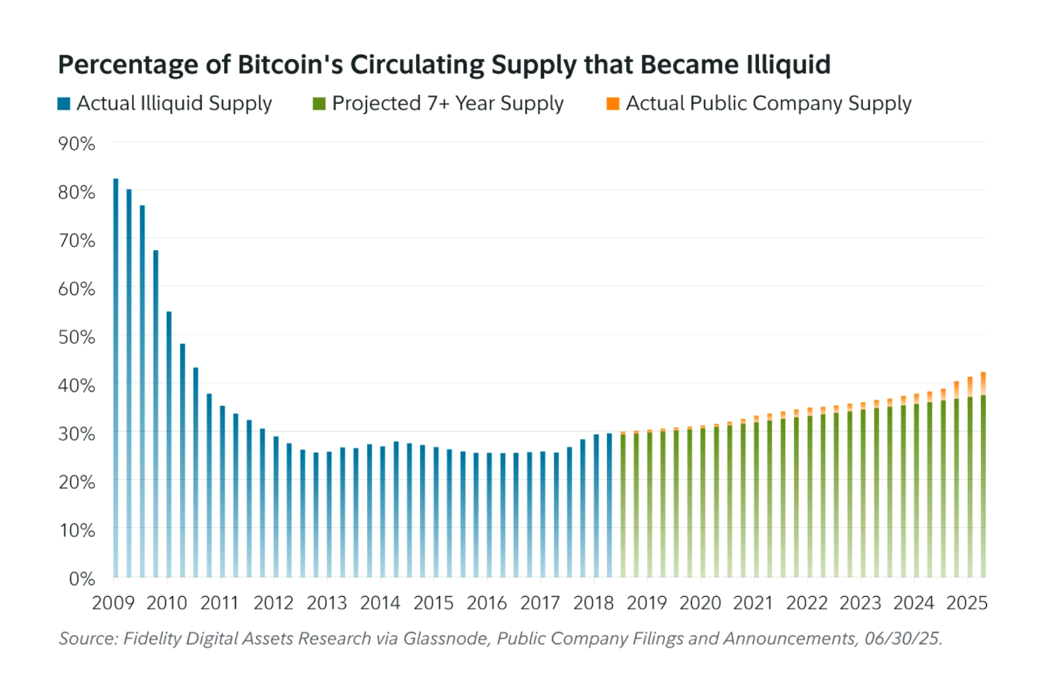
Chart: Fidelity

Slide 83
Illiquid Bitcoin Supply
Analysts at Fidelity Digital Assets found that:
At the end of Q2 2025, Bitcoin’s circulating supply was about 19.8 million.
Nearly 42% (over 8.3 million bitcoin) is estimated to become illiquid by Q2 2032.
This illiquid supply likely exists at present in 2025, but cannot be confirmed as the seven-year period used in Fidelity analysts’ methodology has not yet elapsed.
Bitcoin treasuries have a partial effect, but are not the sole factor, in the trend.
“This highlights a continuing trend of bitcoin’s finite supply becoming relatively more illiquid over time, with additional momentum provided by bitcoin treasury companies,” the report notes.

Slide 84
The Importance of Scarcity
“Bitcoin has always been scarce with a maximum supply of 21 million. However, the mindset of early bitcoin adopters was one of abundance. In 2010, for example, virtual bitcoin “faucets” gave site visitors five bitcoin at the click of a button—an amount valued at over half a million dollars today. This significant shift in perceived value has sharpened the focus on the asset’s scarcity.”
“When a finite supply is met with increasing demand, the only variable left to change is price. As public companies, nation-states, and long-term holders position themselves for the future of Bitcoin, scarcity has never been more top of mind.”
— Fidelity Digital Assets, “Bitcoin’s Illiquid Supply: A New Era for Investors”

Slide 85
Bitcoin Fundamentals
Is Bitcoin Undervalued, and Do Treasuries Stand to Gain?

Slide 86

Expert Commentary
“... It’s clear that Bitcoin has been trading well below the levels implied by its fundamental models.”
“This is the case with trend line analysis and models such as stock-to-flow, Metcalfe’s law, and power law.”
“That persistent gap between model value and market price presents a compelling argument that Bitcoin is undervalued. Meanwhile, companies holding large Bitcoin treasuries are essentially accumulating a de facto undervalued asset on their balance sheets, and when Bitcoin closes the gap, these companies may stand to reap outsized benefits.”
– Brian Dixon, CEO of Off The Chain Capital
Image: FinNotes

Slide 87
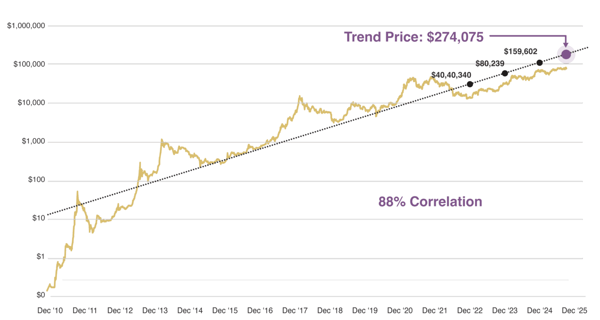
Historical Price Trend
Chart: Off the Chain Capital. Bitcoin Price Source: http://coinmarketcap.com. Data as of 10/13/25.

Slide 88
Perpetual Leverage Without Margin
How Can Companies Endure Volatility In Bear Markets?

Slide 89

Staff Comment
"One silver lining in an otherwise volatile, low-sentiment month that included a massive liquidation flush was a valuable lesson on leverage: not all leverage is created equal. As Strive CIO Ben Werkman has put it, “the type of leverage you have matters a lot.”
“Bitcoin treasury companies have a unique advantage here: we can sustain perpetual leverage without margin, allowing us to ride out volatility through bear markets. An individual can’t replicate that as efficiently, which makes Bitcoin treasury companies that much more compelling."
— Ethan Peck, Director of Bitcoin, Strive Asset Management
Image: Ethan Peck

Slide 90
Stock Prices

Slide 91
Stock Movements
Surveying 19 “pure play” Bitcoin treasuries, we found that all observed stock prices fell over a three month period — confirming that investors who purchased stock in mid-to-late summer are overwhelmingly down on their Bitcoin treasuries investments.
However, we found that four pure play stocks are up year-to-date as of Nov. 5 – Capital B, Metaplanet, and Satsuma, and XXI’s pre-SPAC shares (CEP).
Furthermore, these stocks outperformed the S&P 500 YTD by returning over 15%, and early investors may remain at an advantage.
This analysis focuses on companies chosen at our discretion for having a business strategy that is primarily focused on accumulating Bitcoin. It does not reflect all companies listed on BitcoinTreasuries.net.

Slide 92
Stock Movement (Sorted by YTD Price Change)
Ticker | Name | Last Price | Price Chg. % (1M) | Price Chg. % (3M) | Price Chg. % (YTD)
ALCPB | The Blockchain Group [Capital B] | 0.897 | -27.78% | -65.37% | 198.01%
CEP | Cantor Equity Partners Inc. [XXI]* | 17.51 | -27.97% | -35.22% | 68.53%
3350 [MTPLF] | Metaplanet Inc. | 441 | -29.10% | -52.38% | 26.72%
SATS | Satsuma Technology PLC | 0.014 | 4.89% | -72.65% | 16.25%
SPY | SPDR S&P 500 ETF | 677.58 | 1.25% | 7.90% | 15.61%
CINGF | Coinsilium Group Limited | 0.0431 | -37.45% | -52.11% | -10.11%
MSTR | Strategy Inc | 255 | -27.48% | -32.08% | -11.95%
ADE | Bitcoin Group SE | 35.02 | -14.08% | -13.74% | -30.38%
NAKA | Kindly MD Inc. | 0.8078 | -28.51% | -88.84% | -34.85%
BLGV | Belgravia Hartford Capital Inc. | 0.04 | -42.86% | -83.67% | -38.46%
LQWD | LQWD Technologies Corp. | 1.16 | -32.16% | -56.55% | -44.76%
SMLR | Semler Scientific Inc. | 28.74 | -5.96% | -17.58% | -46.78%
BTC | London BTC Company Limited | 0.033 | -32.65% | -46.12% | -79.05%
EMPD | Empery Digital Inc. | 6.61 | -15.04% | -32.27% | -81.09%
SQNS | Sequans Communications S.A. | 6.21 | -36.44% | -52.95% | -82.21%
H100 | H100 Group AB (publ) | 3.22 | -28.44% | -57.41%
CEPO | Cantor Equity Partners I Inc. [BSTR]* | 10.45 | -0.19% | -3.06%
TSWCF | The Smarter Web Company Plc | 0.666 | -49.92% | -76.00%
BTCB | B Treasury Capital AB (publ) | 177 | -23.04% | -41.00%
BTCT | Bitcoin Treasury Corporation | 7.21 | -11.10% | -14.67%
Data: Koyfin, Nov. 5 *CEP and CEPO represent the pre-SPAC shares of XXI and BSTR, respectively

Slide 93
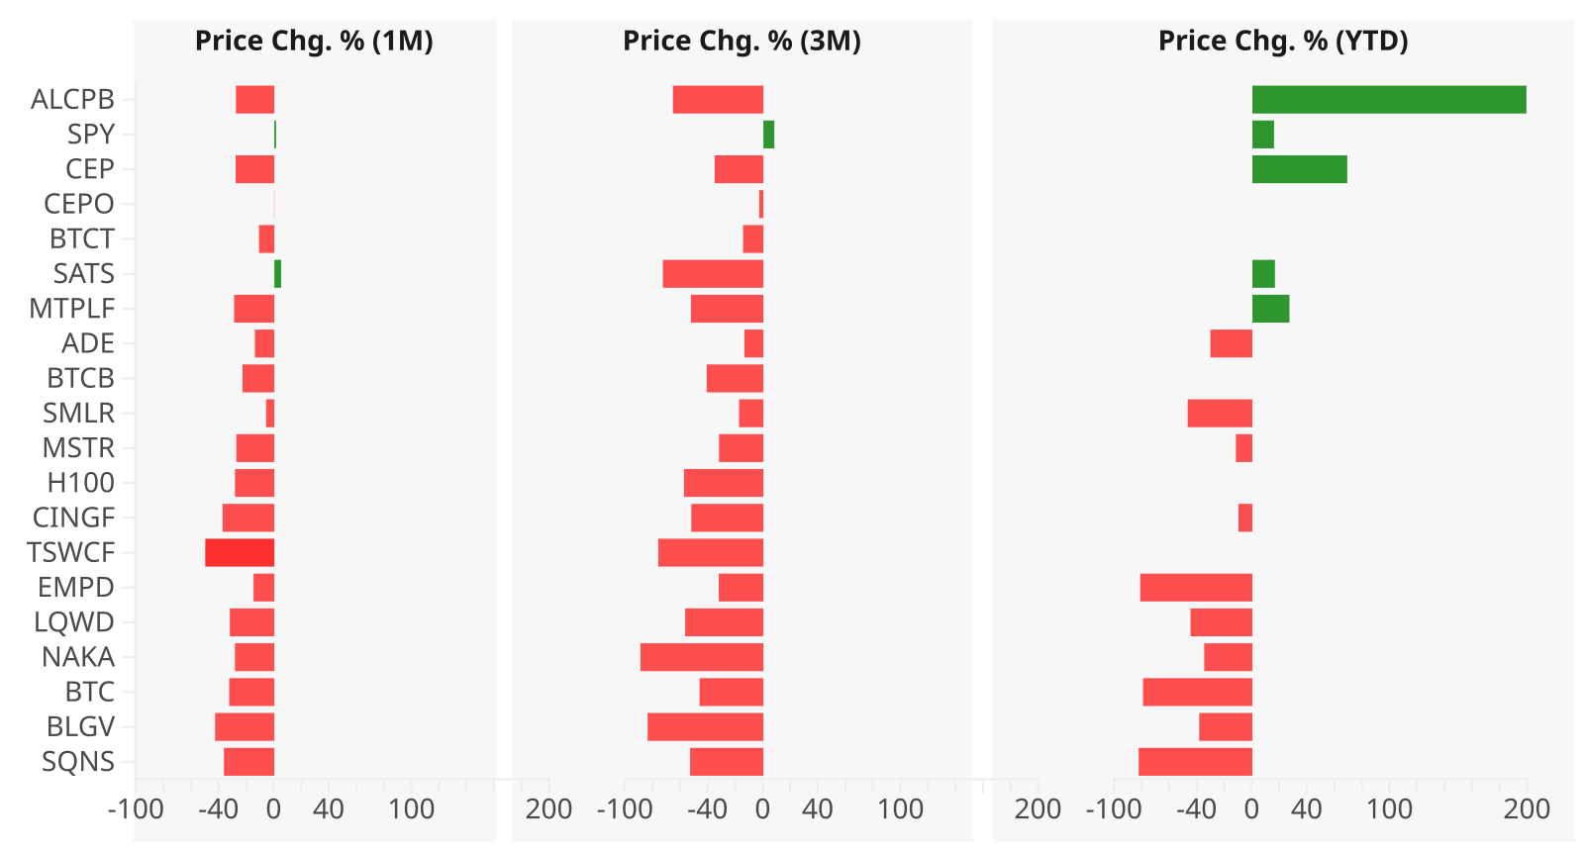
Stock Performance – Visualized
Data: Koyfin, Nov. 5, Chart BitcoinTreasuries.net

Slide 94
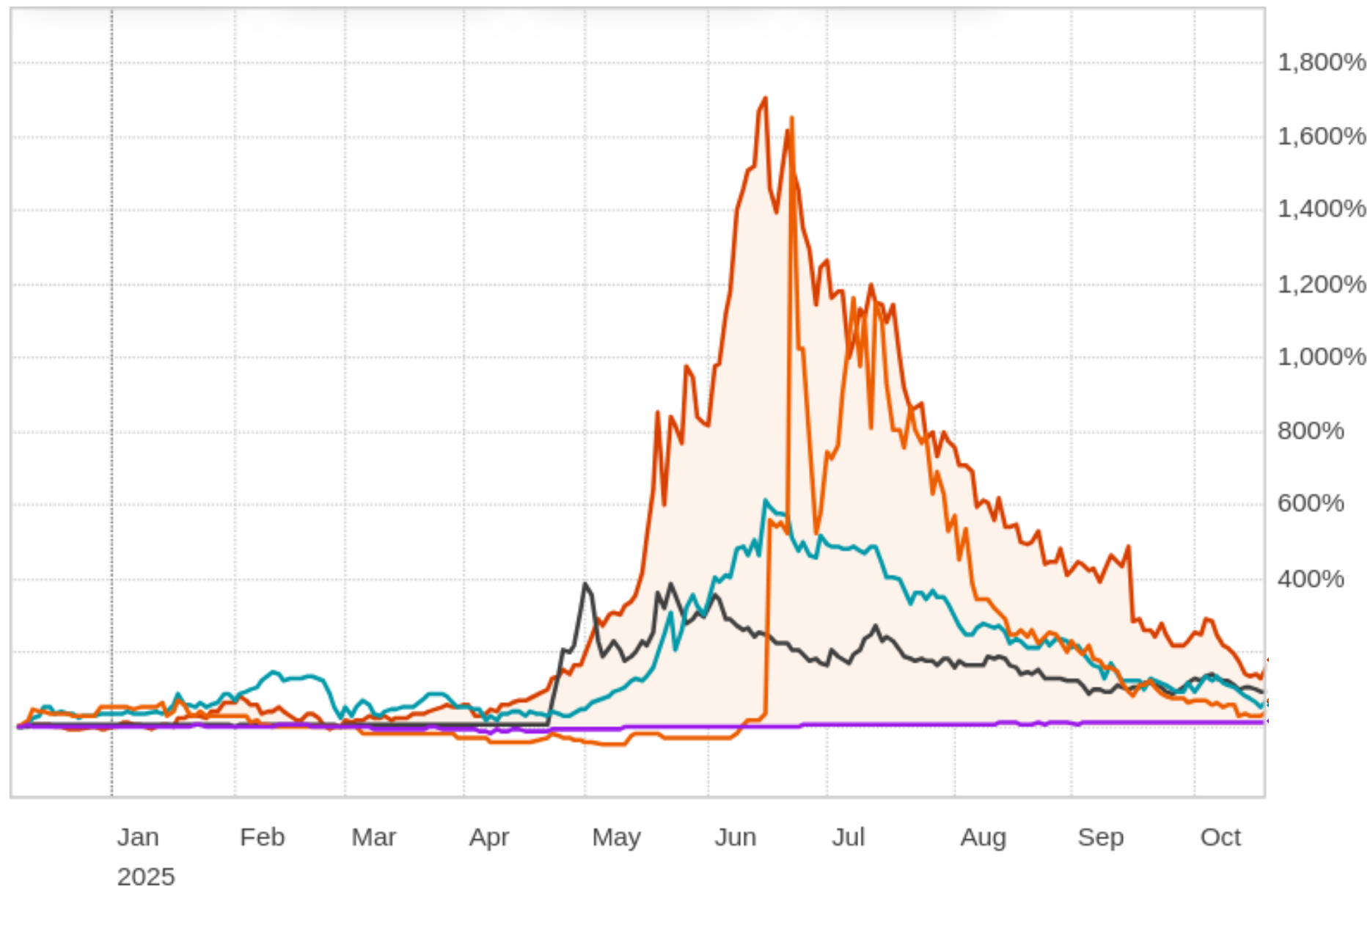
Top Stock Trends – YTD
CEP SATS ALCBP
MTPLF SPY
Chart: Reuters, Nov. 11

Slide 95
Notable Events

Slide 96
Sequans Sells Third of BTC Holdings

Slide 97
Sequans Sells Third of BTC Holdings
On Nov. 4, Sequans said it sold 970 BTC, nearly one-third of its prior holdings, reducing its outstanding debt from $189 million to $94.5 million.
Though other treasuries have sold their holdings, this sale was especially significant due to the amount involved and Sequans’ major standing as a Bitcoin treasury.
The company defended the action, stating: “Our Bitcoin treasury strategy and our deep conviction in Bitcoin remain unchanged … This transaction was a tactical decision aimed at unlocking shareholder value given current market conditions.”
The sale of Bitcoin aims to boost the company’s ADS buyback program.
Critics argue that Sequans’ action has violated the core principle of a treasury strategy — a dedication to holding and accumulating Bitcoin.

Slide 98
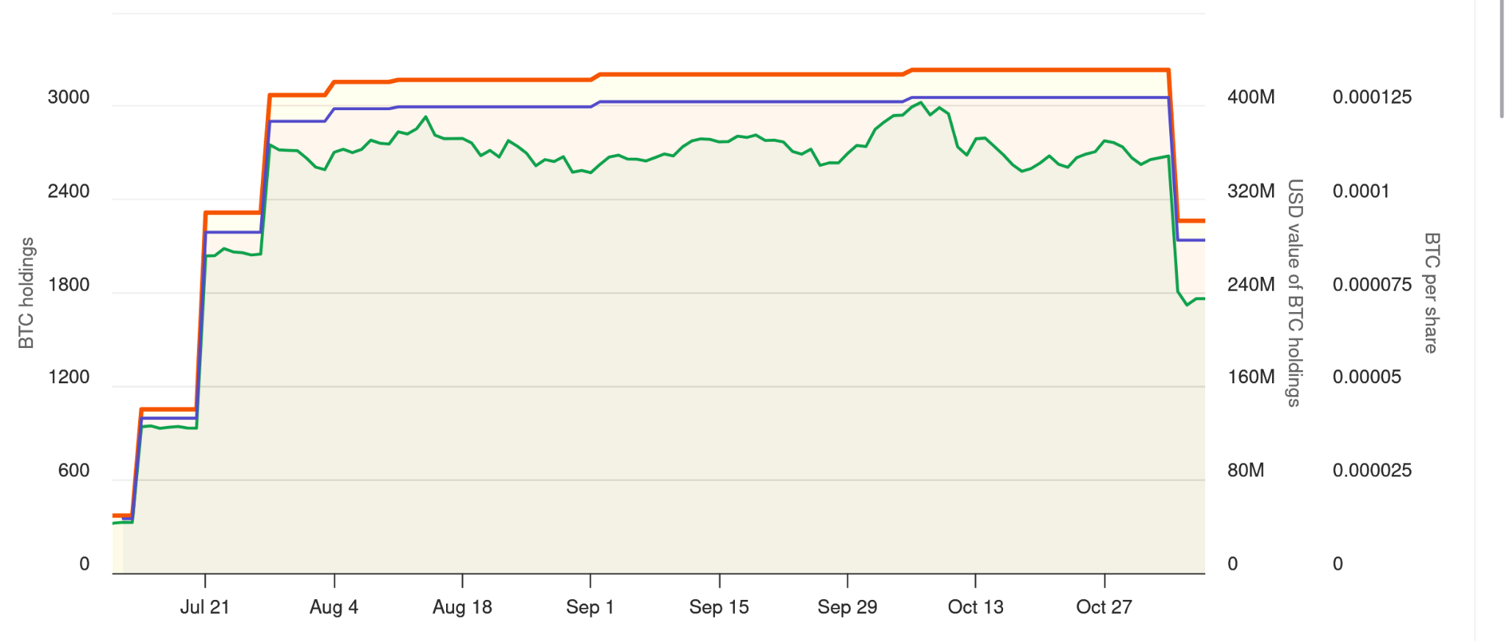
Sequans Sells Third of BTC Holdings

Slide 99
Jiuzi Plans to Stake 10,000 BTC

Slide 100
Jiuzi Plans to Stake 10,000 BTC
Jiuzi Holdings is pursuing a somewhat unique strategy for its holdings: deploying up to 10,000 Bitcoin into SolvBTC.BNB, a BNB Chain-based staking platform.
The company could allocate the full amount of its $1 billion digital asset plan — although BitcoinTreasuries.net data indicates Jiuzi holds just 100 BTC ($10 million) at present.
The allocation of funds would also constitute a significant addition to SolvBTC.BNB, which held about $1.07 billion in total value locked on Nov. 10.
Jiuzi Holdings CEO Li Tao called the partnership “a powerful accelerator for achieving our vision of becoming the premier platform for global institutions to access Bitcoin and will unlock a clear path to immense value creation for our company and shareholders."
Staking is already somewhat common in Ethereum treasuries, such as BitMine and SharpLink, but it remains to be seen whether this trend will grow among Bitcoin treasuries specifically.

Slide 101
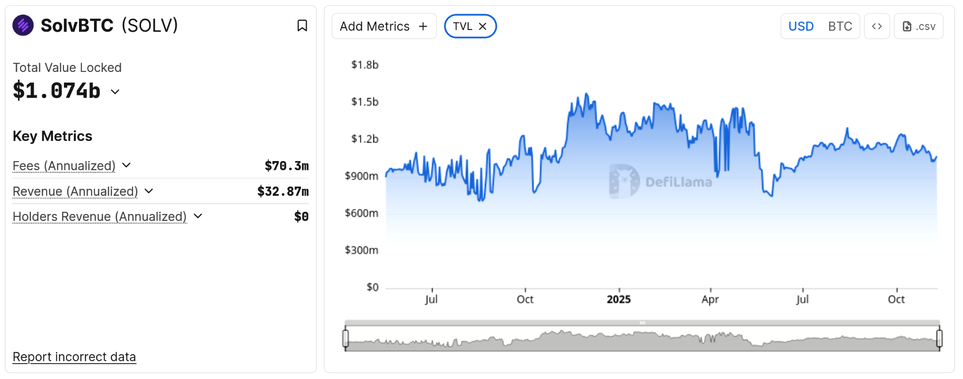
SolvBTC Holdings
Chart: DeFiLlama

Slide 102
Strategy Receives B- Credit Rating

Slide 103
Strategy Receives B- Credit Rating
Strategy notably received a B- credit rating for its business activities from S&P Global.
While some headlines highlighted the rating’s “junk bond” status and risk of default, the rating itself emphasizes a stable outlook in accordance with the expectation that Strategy will continue to prudently manage maturities of its convertible debt.
S&P Global adds that Strategy’s various risks are only partially offset by its “strong access to capital markets and prudent management of its capital structure.”
The rating also highlighted an “inherent currency mismatch,” with the company holding a large amount of Bitcoin but owing dividends, maturities, and debt interest in U.S. dollars.
Strategy executive chair Michael Saylor, meanwhile, called the designation “the first-ever rating of a Bitcoin Treasury Company by a major credit rating agency.”

Slide 104
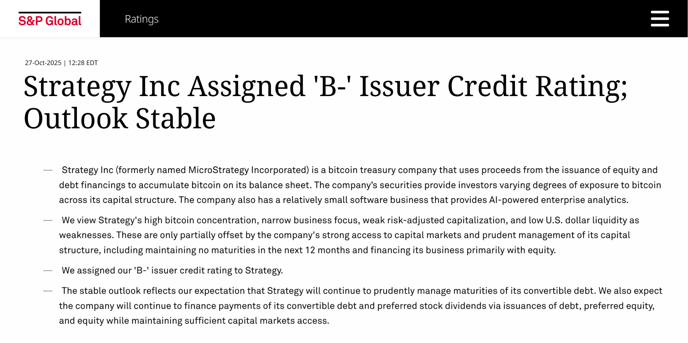
Image: Edited from https://www.spglobal.com/ratings/en/regulatory/article/-/view/type/HTML/id/3466223

Slide 105
Other Headlines

Slide 106
Other Headlines
Positive coverage of Bitcoin treasuries continued throughout September and October:
Forbes published “Past Midnight, The Crypto Treasury Party Is Just Getting Started,” noting interest among investors and startups despite risks
Fidelity recognized digital assets as a “legitimate treasury allocation,” noting the trend resembles the adoption curve of earlier transformative technologies
Barron’s called crypto treasuries “the new SPACs,” highlighting their fundraising potential
Bloomberg noted “Saylor’s Strategy Resumes Bitcoin Splurge at Highest Price Ever”

Slide 107
Other Headlines
Skepticism toward Bitcoin treasuries also remains widespread:
MarketWatch headlined “Many crypto-treasury companies are trading for less than what their digital assets are worth. Is this a bargain or a big red flag?”
Forbes urged digital asset treasuries to turn to “active, diversified strategies” for their survival and warned of declining valuations in a $150 billion shakeout
WealthBriefing called Bitcoin treasuries an “accident waiting to happen,” citing significant negative sentiment and concern expressed in a survey of bankers
The Wall Street Journal declared that the “hot crypto-treasury summer” has come to an end
Bloomberg and Business Insider said that retail investors have lost $17 billion on Bitcoin treasuries, citing a report from 10x Research

Slide 108
Fundraising and Capital

Slide 109
Overview
Fundraisers allocated toward treasury purchases continued at a significant pace this month.
Press releases in and around October described over $10 billion in fundraisers, including at least $1.4 billion related to Bitcoin treasuries and over $8.7 billion related to altcoin treasuries, with proceeds wholly or partially allocated to those strategies.
Plus, summer data from Keyrock indicates that fundraisers to date amount to at least $33 billion across various categories of debt and equity, with different companies taking on different levels of risk through their unique strategies.
This section tracks the latest developments.

Slide 110
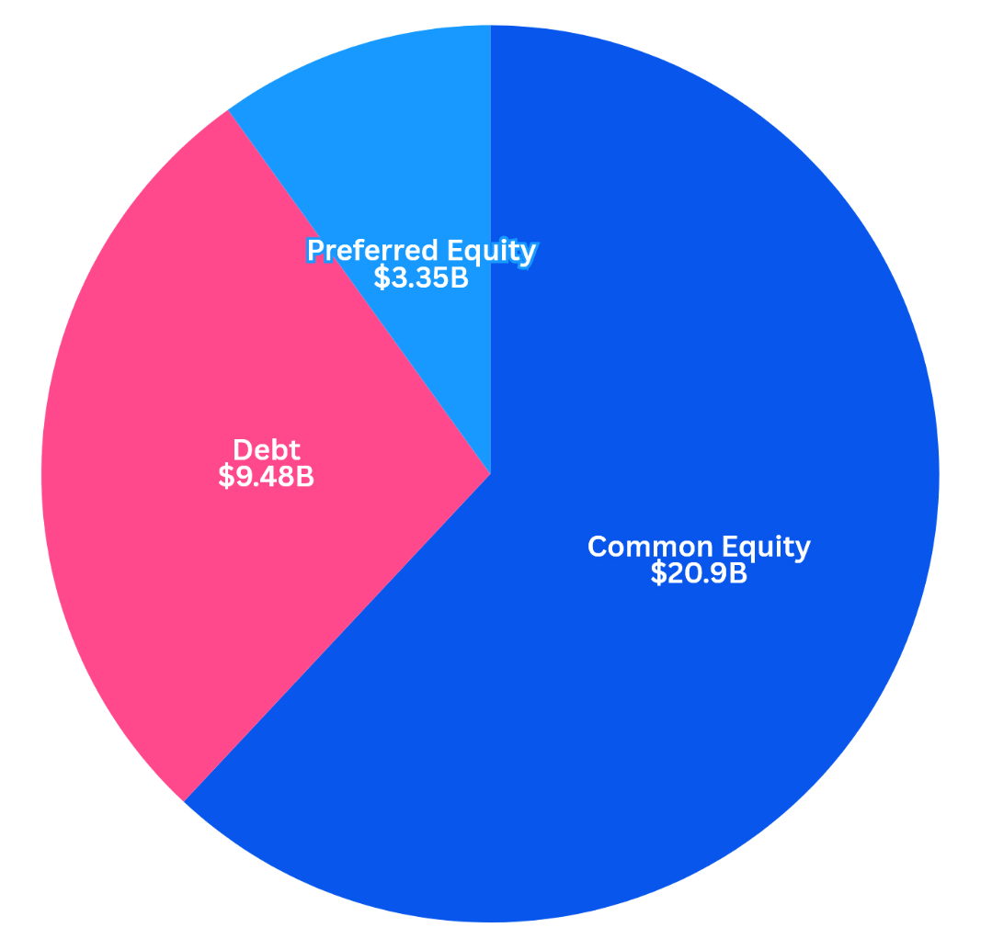
Fundraiser Amounts – Visually
“BTC-TCs have collectively raised ~$33.7 billion in capital to fund BTC acquisitions. This consists of ~$20.9 billion in common equity issuance, ~$3.35 billion in preferred equity, and ~$9.48 billion in debt.”
“... This translates to a wall of maturities in 2027 and 2028, as well as frequent interest and dividend payments from present through 2031.“
– Keyrock: BTC Treasuries Uncovered, by Ben Harvey and Will Clemente III
Chart: BitcoinTreasuries.net
Data: Keyrock (Published July 10)

Slide 111
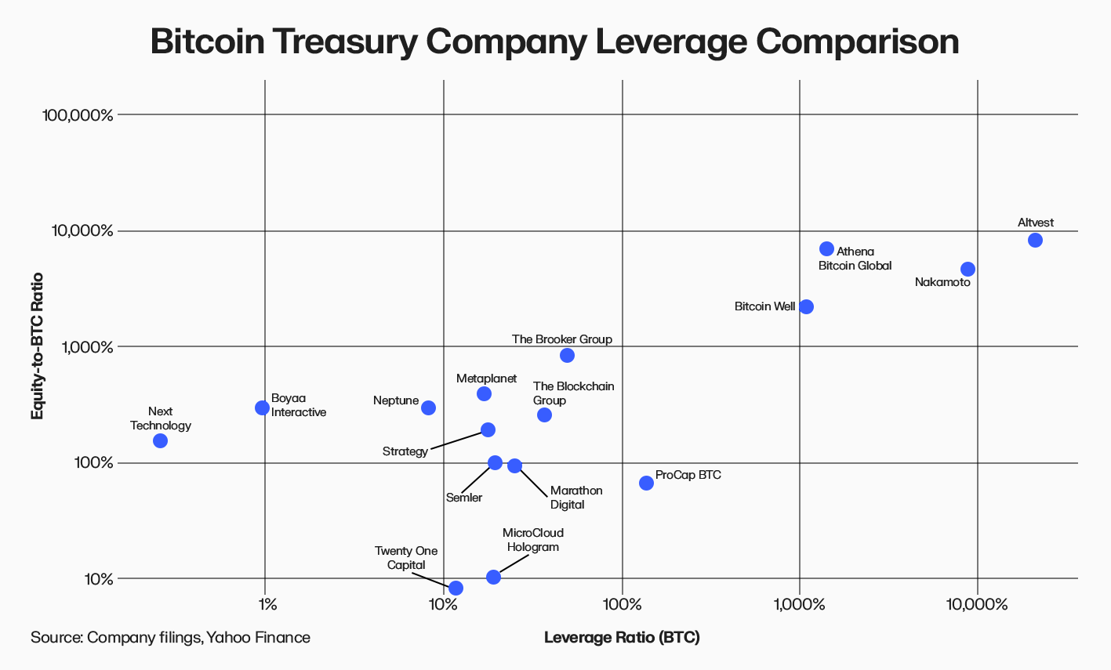
Leverage Ratio
“The Leverage Ratio shows how much financial leverage, measured through debt and preferred equity raises, a company has used to acquire each unit of BTC. A higher ratio implies more borrowed capital or quasi-debt has been used per BTC held, indicating a somewhat risker but more capital-efficient structure.”
– Keyrock: BTC Treasuries Uncovered
Chart: Keyrock (Published July 10)

Slide 112
Fundraisers
Strategy’s STRE preferred shares are expected to raise €620 million ($715 million) [Nov. 7]
Bitfarms aims to raise $300 million through convertible notes [Oct. 15]
Strive raised $160 million from its SATA offering and used the proceeds to buy BTC [Nov. 10]
DDC Enterprise secured $124 million in equity toward its Bitcoin treasury strategy [Oct. 8]
Metaplanet’s recent credit line will go toward buying Bitcoin and its Bitcoin Income Generation business alongside share repurchases [Oct. 28]
Prenetics closed a $44 million equity offering toward its Bitcoin treasury [Oct. 28]
AMDAX, set to launch the AMBTS Bitcoin treasury, has raised €30 million ($35M) [Oct. 7]

Slide 113
Fundraisers
Future Holdings raised 28 million Swiss francs ($34.5 million) for its BTC treasury [Nov. 5]
Smarter Web Company announced 13.5 million GBP ($17 million) in proceeds across various raises during October [Oct. 1 - Oct. 20]
Coinsilium reported raising 11.62 million GBP ($15 million) since mid-May [July 11]
RSXYZ approved a 168 million THB ($5 million) fundraiser for its Bitcoin strategy [Sept. 30]
Canadian public company LQWD Technologies raised $1.85 million [Sept. 25]
Buccaneer Energy has raised approximately 500,000 GBP ($675,000), primarily set for its Bitcoin mining expansion, though a Bitcoin treasury is also planned [Nov. 3]

Slide 114
Altcoin Fundraisers
Forward Industries announced an up to $4 billion ATM offering for its SOL treasury [Sept. 17]
Evernorth will raise $1 billion for a leading public XRP treasury, funded by SBI, Ripple, and others [Oct. 20]
Huobi founder Li Lin and Ethereum pioneers in Asia are putting $1 billion toward an ETH treasury [Oct. 17]
Avalanche Treasury Co. announced a $675 million merger for its AVAX treasury [Oct. 1]
China Renaissance aims to raise $600 million for its BNB treasury [Oct. 13]
Tharimmune raised $540 million for Canton Coin (CC) treasury [Nov. 3]
Bitmine announced a direct offer expected to raise $365 million [Sept. 22]
Zanker is raising $200 million to launch a treasury company for its TRUMP memecoin [Oct. 8]
Polychain Capital is leading a $110 million fundraiser toward a Berachain (BERA) treasury [Oct. 20]
Pineapple completed a $100 million raise for its Injective token strategy, purchasing $8.9 million [Oct. 7]
SharpLink announced $76.5 million equity sale toward ETH accumulation [Oct. 16]
Vivopower raised an extra $19 million for its XRP treasury company [Oct. 1]
TAO Synergies announced an $11 million private placement for its Bittensor token treasury [Oct. 13]
Igraine has raised 7.2 million GBP ($9.4 million USD) for its Ethereum treasury strategy [Oct. 14]

Slide 115
Altcoin Holdings

Slide 116
Altcoin Holdings
Bitcoin treasuries remain the dominant type of crypto treasury. Public companies now hold more than 1.05 million BTC, greatly overshadowing treasuries that hold other cryptocurrencies such as Ethereum (ETH) and Solana (SOL).
However, it appears that Ethereum treasuries are gradually accounting for a larger proportion of treasury holdings when converted to dollar value.
Comparing three categories, we see that:
BTC holdings account for about 82% of dollar value, down from 94% in April
ETH holdings account for about 15% of dollar value, up from 2.5% in April
SOL holdings account for 2-3% of dollar value, about the same as in April
Note that some of this growth may be due to increased efforts to track holdings, with little data for altcoin treasuries existing before early 2025.

Slide 117
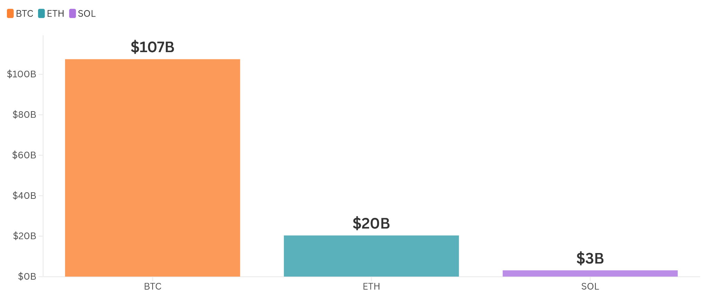
Treasury Holdings by Cryptocurrency — Current
Chart: BitcoinTreasuries.net. Data: BTC holdings last day of month: BitcoinTreasuries.net. ETH holdings last day of month: strategicethreserve.xyz.
SOL holdings: 25th day of month strategicsolanareserve.org. USD values based on Nov. 8 prices. $101944/BTC, $3397/ETH, $157.77/SOL.

Slide 118
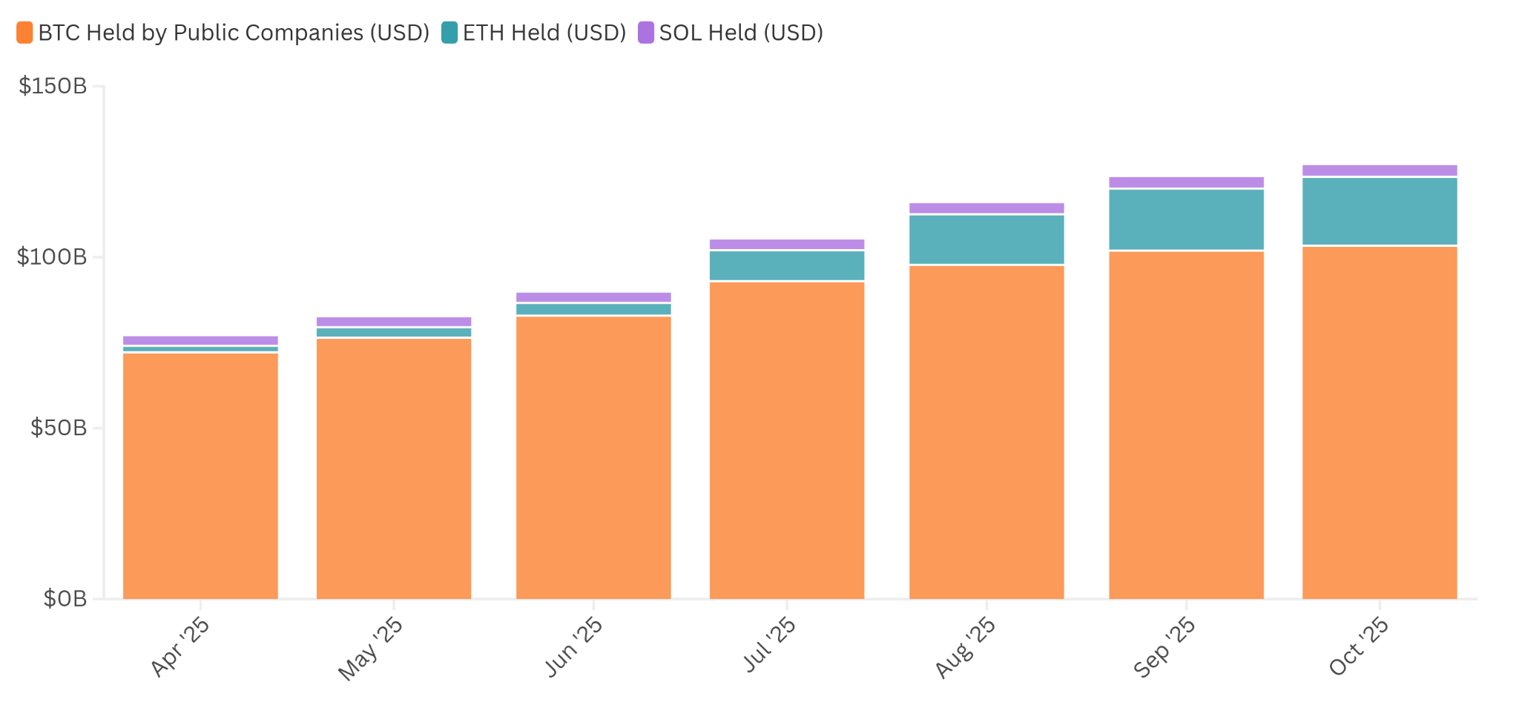
Treasury Holdings by Cryptocurrency Over Time
Chart: BitcoinTreasuries.net. Data: BTC holdings last day of month: BitcoinTreasuries.net. ETH holdings last day of month: strategicethreserve.xyz.
SOL holdings: 25th day of month strategicsolanareserve.org. USD values based on rough YTD midline estimates: $98000/BTC, $3362.6/ETH, $174.95/SOL.

Slide 119
Ethereum Treasuries
6.1 million ETH
Valued above $20 billion

Slide 120
Ethereum (ETH) Holdings
Ethereum treasuries remain a significant counterpart to Bitcoin treasuries.
About 70 treasuries held 6.1 million ETH on Oct. 31, per Strategic ETH Reserve.
The total value of all ETH treasuries was above $20 billion as of Nov. 8.
Treasuries collectively added over 500,000 ETH to the previous month’s 5.5 million ETH total, meaning that purchases and additions continued at a moderate pace.
The most notable recent buyer is Bitmine, which has increased its holdings by about 20% over 30 days, according to Strategic ETH Reserve data. Official statements indicate the company holds 3.4 million ETH as of Nov. 3.

Slide 121
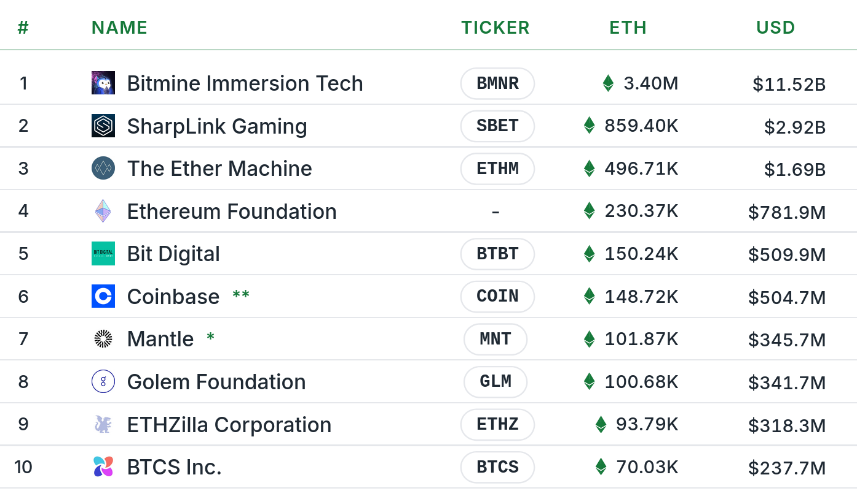
Top 10 Ethereum Treasuries
Image: strategicethreserve.xyz, Nov. 8

Slide 122
Solana Treasuries
20 million SOL
Valued at $3.2 billion

Slide 123
Solana (SOL) Treasuries
Solana treasuries also continue to present a significant alternative.
At least 20 companies have a Solana treasury, per the Strategic Solana Reserve.
Those firms held over 20 million SOL as of Nov. 8, worth about $3.2 billion.
Treasuries added about 650,000 SOL between Sept. 25 and Oct. 25.
Top holders include Forward Industries Inc (FORD), Solana Company (HSDT) and DeFi Development Corp (DFDV), accounting for over half of all holdings.

Slide 124
Solana (SOL) Treasuries
# | Entity | SOL | USD
1 | Forward Industries Inc FORD | 6.822M | $1.07B
2 | Solana Company HSDT | 2.300M | $361.8M
3 | DeFi Development Corp DFDV | 2.196M | $345.4M
4 | Sharps Technology, Inc. STSS | 2.140M | $336.6M
5 | Upexi, Inc. UPXI | 2.000M | $314.6M
6 | Solmate (Brera Holdings) BREA | 1.215M | $191.1M
7 | Mercurity Fintech MFH | 1.083M | $170.4M
8 | iSpecimen Inc.ISPC | 1.000M | $157.3M
9 | Yueda Digital Holding YDKG | 749.965k | $118.0M
10 | SOL Strategies Inc. CYFRF | 516.421k | $81.2M
11 | DigitalX Limited DCC.AX | 125.390k | $19.7M
12 | Classover Holdings Inc. KIDZ | 61.048k | $9.6M
13 | Artelo Biosciences ARTL | 45.883k | $7.2M
14 | Sol Global Investments Corp SOL.CN | 40.350k | $6.3M
15 | Torrent Capital Ltd. TORR.V | 40.039k | $6.3M
16 | BIT Mining Limited BTCM | 27.191k | $4.3M
17 | ALALO (Acheter-Louer.fr) ALALO.PA | 15.564k | $2.4M
18 | DeFi Technologies Inc. DEFT | 12.775k | $2.0M
19 | Neptune Digital Assets Corp NDA.V | 9.573k | $1.5M
20 | MemeStrategy, Inc. 2440.HK | 2.440k | $383.8K
Based on strategicsolanareserve.org data Nov. 9

Slide 125
XRP Treasuries
More than $1 billion planned

Slide 126
XRP Holdings
Company | XRP Treasury
Quantum Biopharma (QNTM) | Held $148,245 of XRP as part of a $5 million multi-digital asset treasury as of June 30, 2025 (Source)
Hyperscale / Sentinum (GPUS) | Holds 33,120 XRP ($92,000) (Source), plans $10 million (Source)
Flora Growth (FLGC) | Held 44,653 XRP ($99,000) alongside other digital assets as of June 30, 2025 (Source)
Everything Blockchain (EBZT) | Has purchased an unknown XRP amount (Source), plans to buy $10 million in multiple cryptos (Source)
BC Bud (BCBC) | Has begun to purchase XRP (Source) with $250,000 CAD allocated (Source)
Reliance Group (RELI) | Has begun to purchase XRP (Source)
Evernorth | Expected to raise $1 billion (Source) — purchases not yet confirmed
Trident Digital Tech Holdings (TDTH) | Up to $500 million planned (Source)
VivoPower International (VVPR) | $121 million planned (Source)
Webus International (WETO) | Has secured up to $100 million (Source)
Wellgistics Health (WGRX) | Has secured $50 million (Source)
Nature's Miracle Holding Inc. (NMHI) | Up to $20 million planned (Source)
Gumi | Plans to buy 2.5 billion JPY ($17 million) of XRP (Source)
Worksport (WKSP) | Up to $5 million in BTC and XRP planned (Source)

Slide 127
Future Outlook

Slide 128
Looking Forward
Several factors could impact Bitcoin acquisitions in the coming months:
Affordable Bitcoin prices: Bitcoin prices touched $101,000 around Nov. 7 — a drawdown that some treasury companies may view as an affordable buying opportunity.
Sales of Bitcoin holdings: Conversely, declining Bitcoin prices could encourage some treasury companies to sell Bitcoin. Sequans’ sale of 970 BTC in early November will significantly offset any additions that we record over the next month, though a net increase in holdings across all treasury companies is still likely.
Fundraisers and share offerings: Fundraisers continue to generate capital for Bitcoin purchases, generating billions of dollars for future buys.
Foreign treasury activity: American Bitcoin treasuries may attempt to reach into foreign markets with new products, while international companies may see a chance to do the same in the U.S.
Fed interest rate uncertainty: The next interest rate decision is on Dec. 10, and it is unclear whether this will involve a rate cut or an increase — leaving uncertainty for Bitcoin and other markets.

